Slide 1






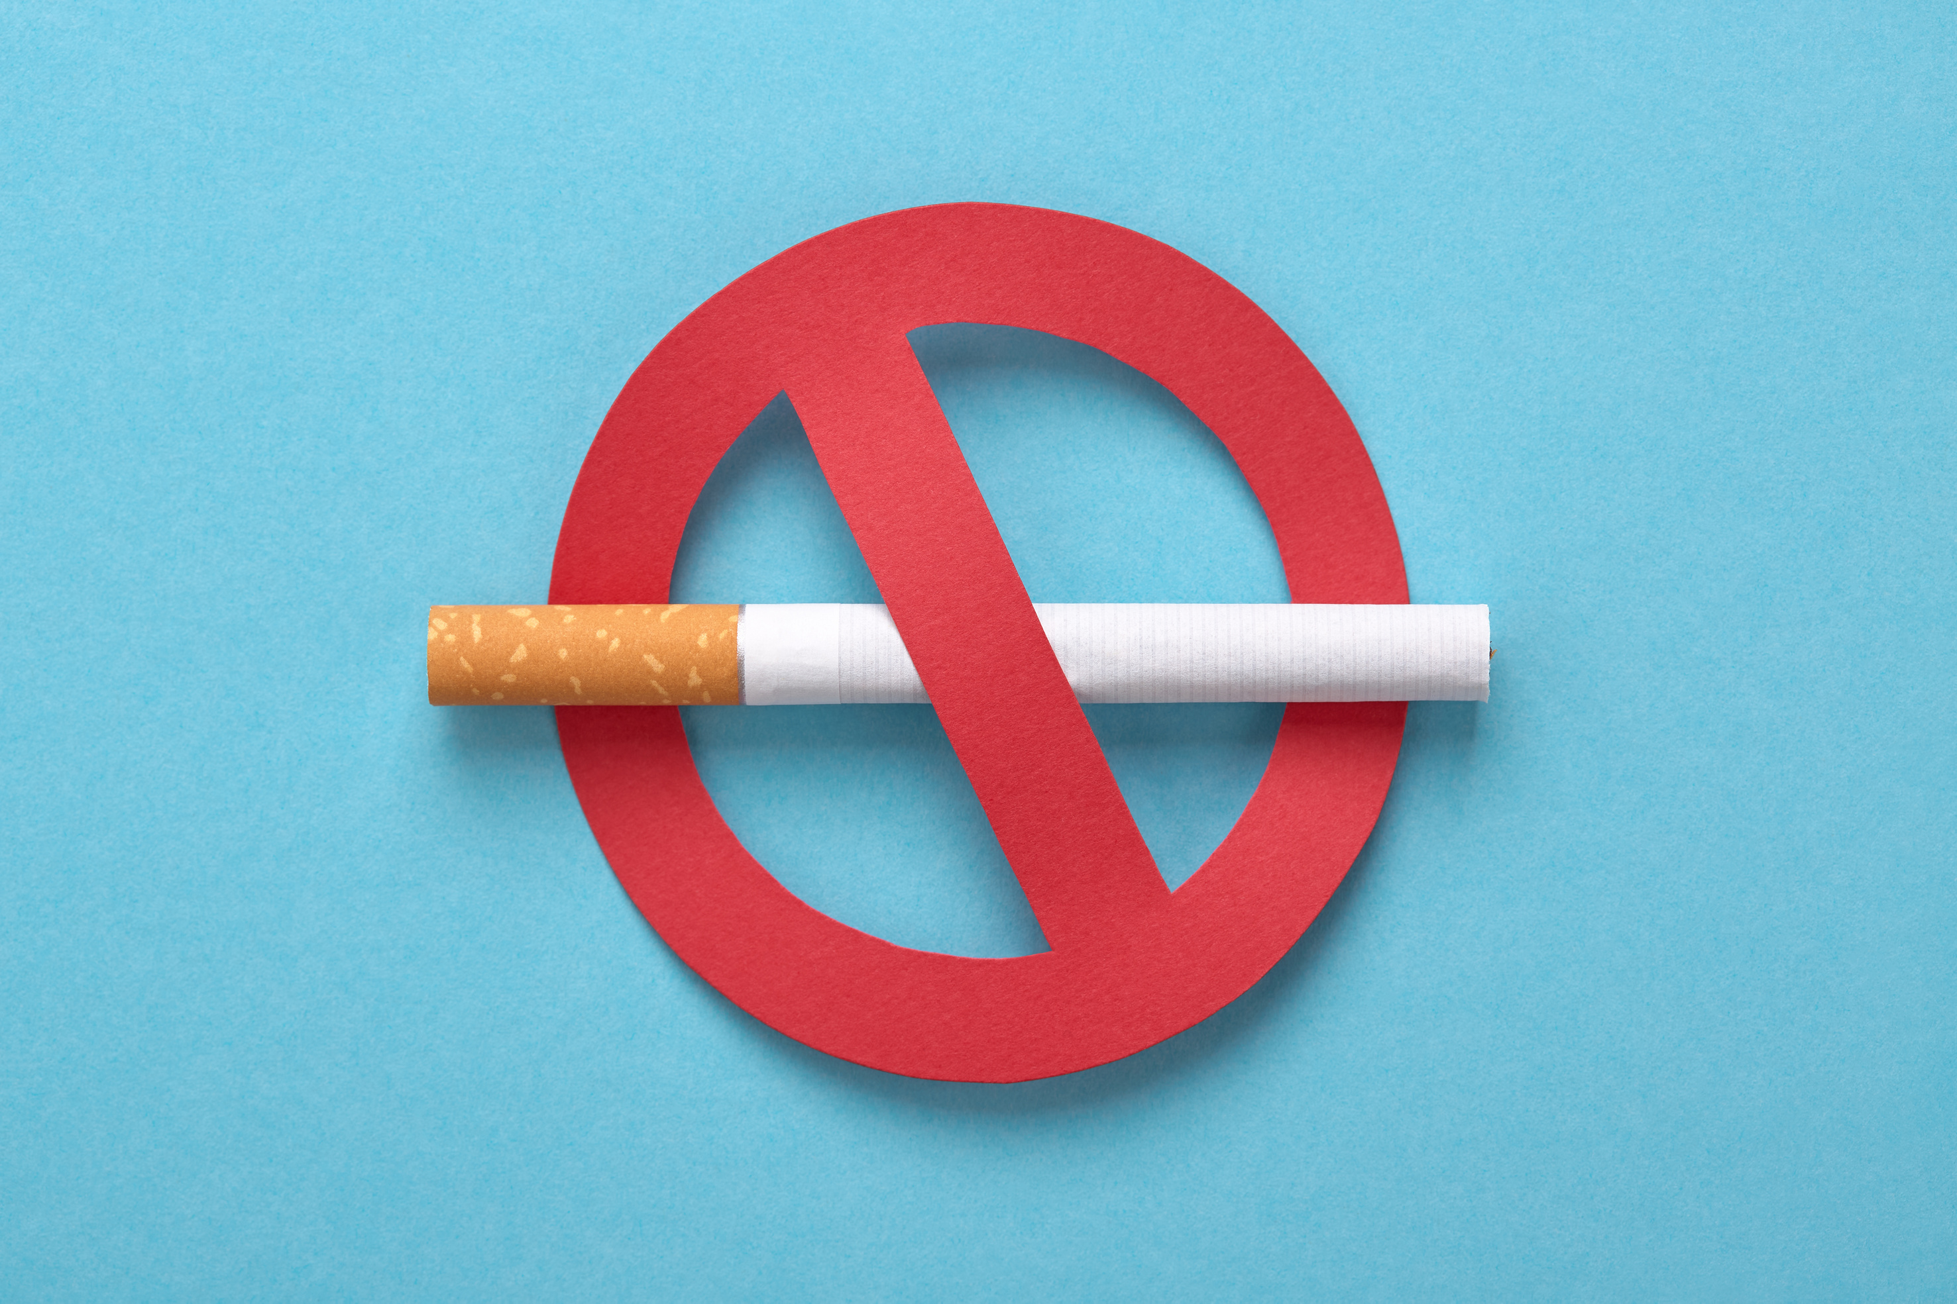
Physical Education and wellness
Substance Use, Addictions
and Related Behaviours
Identifying Harmful Substances and Their Effects
www.onthemarkcurriculum.com

Slide 2


Learning Objective:
Identify harmful substances found in tobacco and vaping products (e.g., nicotine, tar, carbon monoxide) and explain their short- and long-term effects on physical and mental health.
© On The Mark Curriculum OTM414-AB

Slide 3



What are
Harmful Substances?
Some substances in tobacco and vaping products are bad for your health. These include nicotine, tar, and carbon monoxide.
Health Canada
In Canada, the number of smokers has decreased to 10.9% in 2022.
© On The Mark Curriculum OTM414-AB

Slide 4
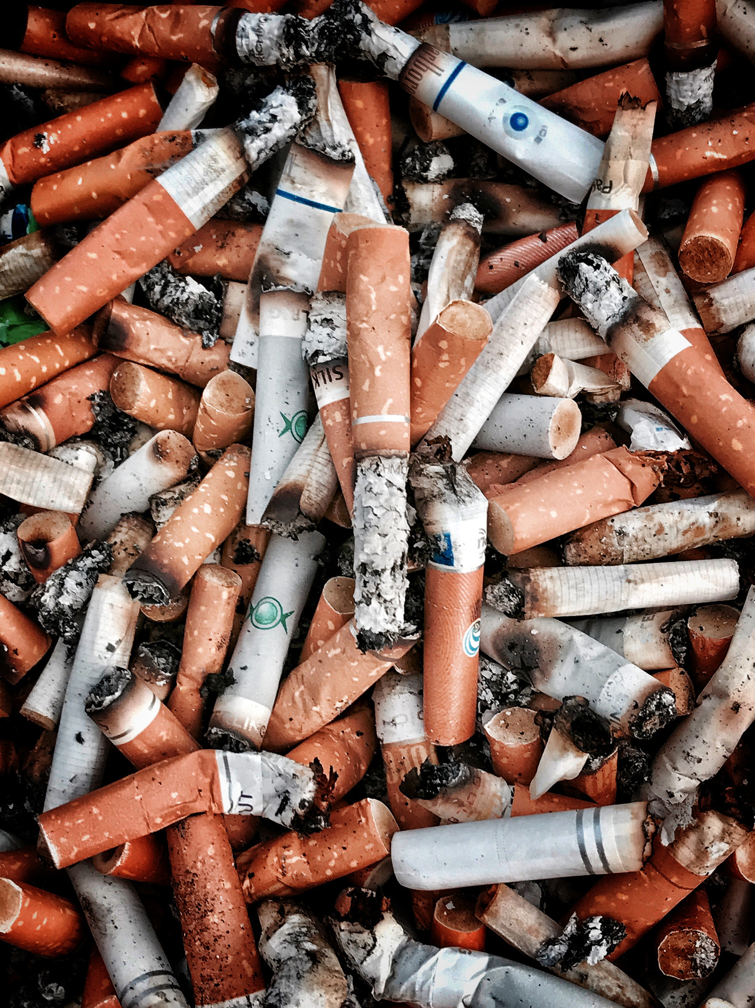

Nicotine
Nicotine is a chemical in tobacco and vape products. It makes people addicted, which means it’s hard to stop using.
© On The Mark Curriculum OTM414-AB

Slide 5
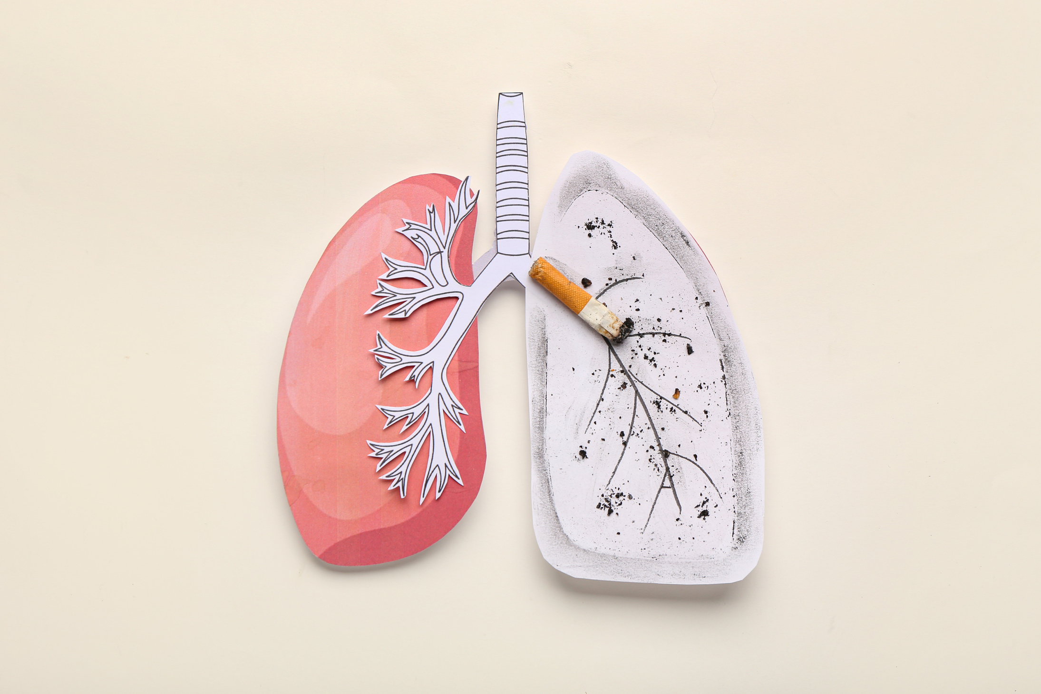

Tar
Tar is a sticky substance found in tobacco smoke. It can damage your lungs and make it hard to breathe.
Tar can also build up over time, causing serious health problems like lung cancer and chronic coughing.
© On The Mark Curriculum OTM414-AB

Slide 6

Carbon Monoxide
Carbon monoxide is a gas in tobacco smoke. It stops oxygen from moving around your body.
This can make your heart and lungs work harder, which is bad for your health.
School
© On The Mark Curriculum OTM414-AB

Slide 7

Why Is Smoking Addictive?
Smoking is addictive because of nicotine. This makes it hard to stop once you start.
© On The Mark Curriculum OTM414-AB

Slide 8

Short-Term Effects of Smoking and Vaping
Smoking and vaping can make you feel dizzy, give you bad breath, or make you cough.
© On The Mark Curriculum OTM414-AB

Slide 9

Long-Term Effects of Smoking and Vaping
Over time, smoking and vaping can hurt your heart and lungs and cause serious diseases.
© On The Mark Curriculum OTM414-AB

Slide 10


Second-Hand Smoke
Second-hand smoke is what other people breathe in from tobacco. It can also harm their health.
It can also impact other people’s breathing, and cause asthma.
© On The Mark Curriculum OTM414-AB

Slide 11



How Vaping
Affects Others
The smell can bother other people.
Vaping can make the air unhealthy to breathe.
It can make others feel uncomfortable.
© On The Mark Curriculum OTM414-AB

Slide 12

Recap and
Review
Choosing not to smoke or vape keeps your body and mind healthy.
© On The Mark Curriculum OTM414-AB

Slide 13


Homework
Extension Task
Research Task
Research a Canadian health organization that educates people about the dangers of smoking and vaping. Write its name and one fact you learned.
© On The Mark Curriculum OTM414-AB

