Slide 1
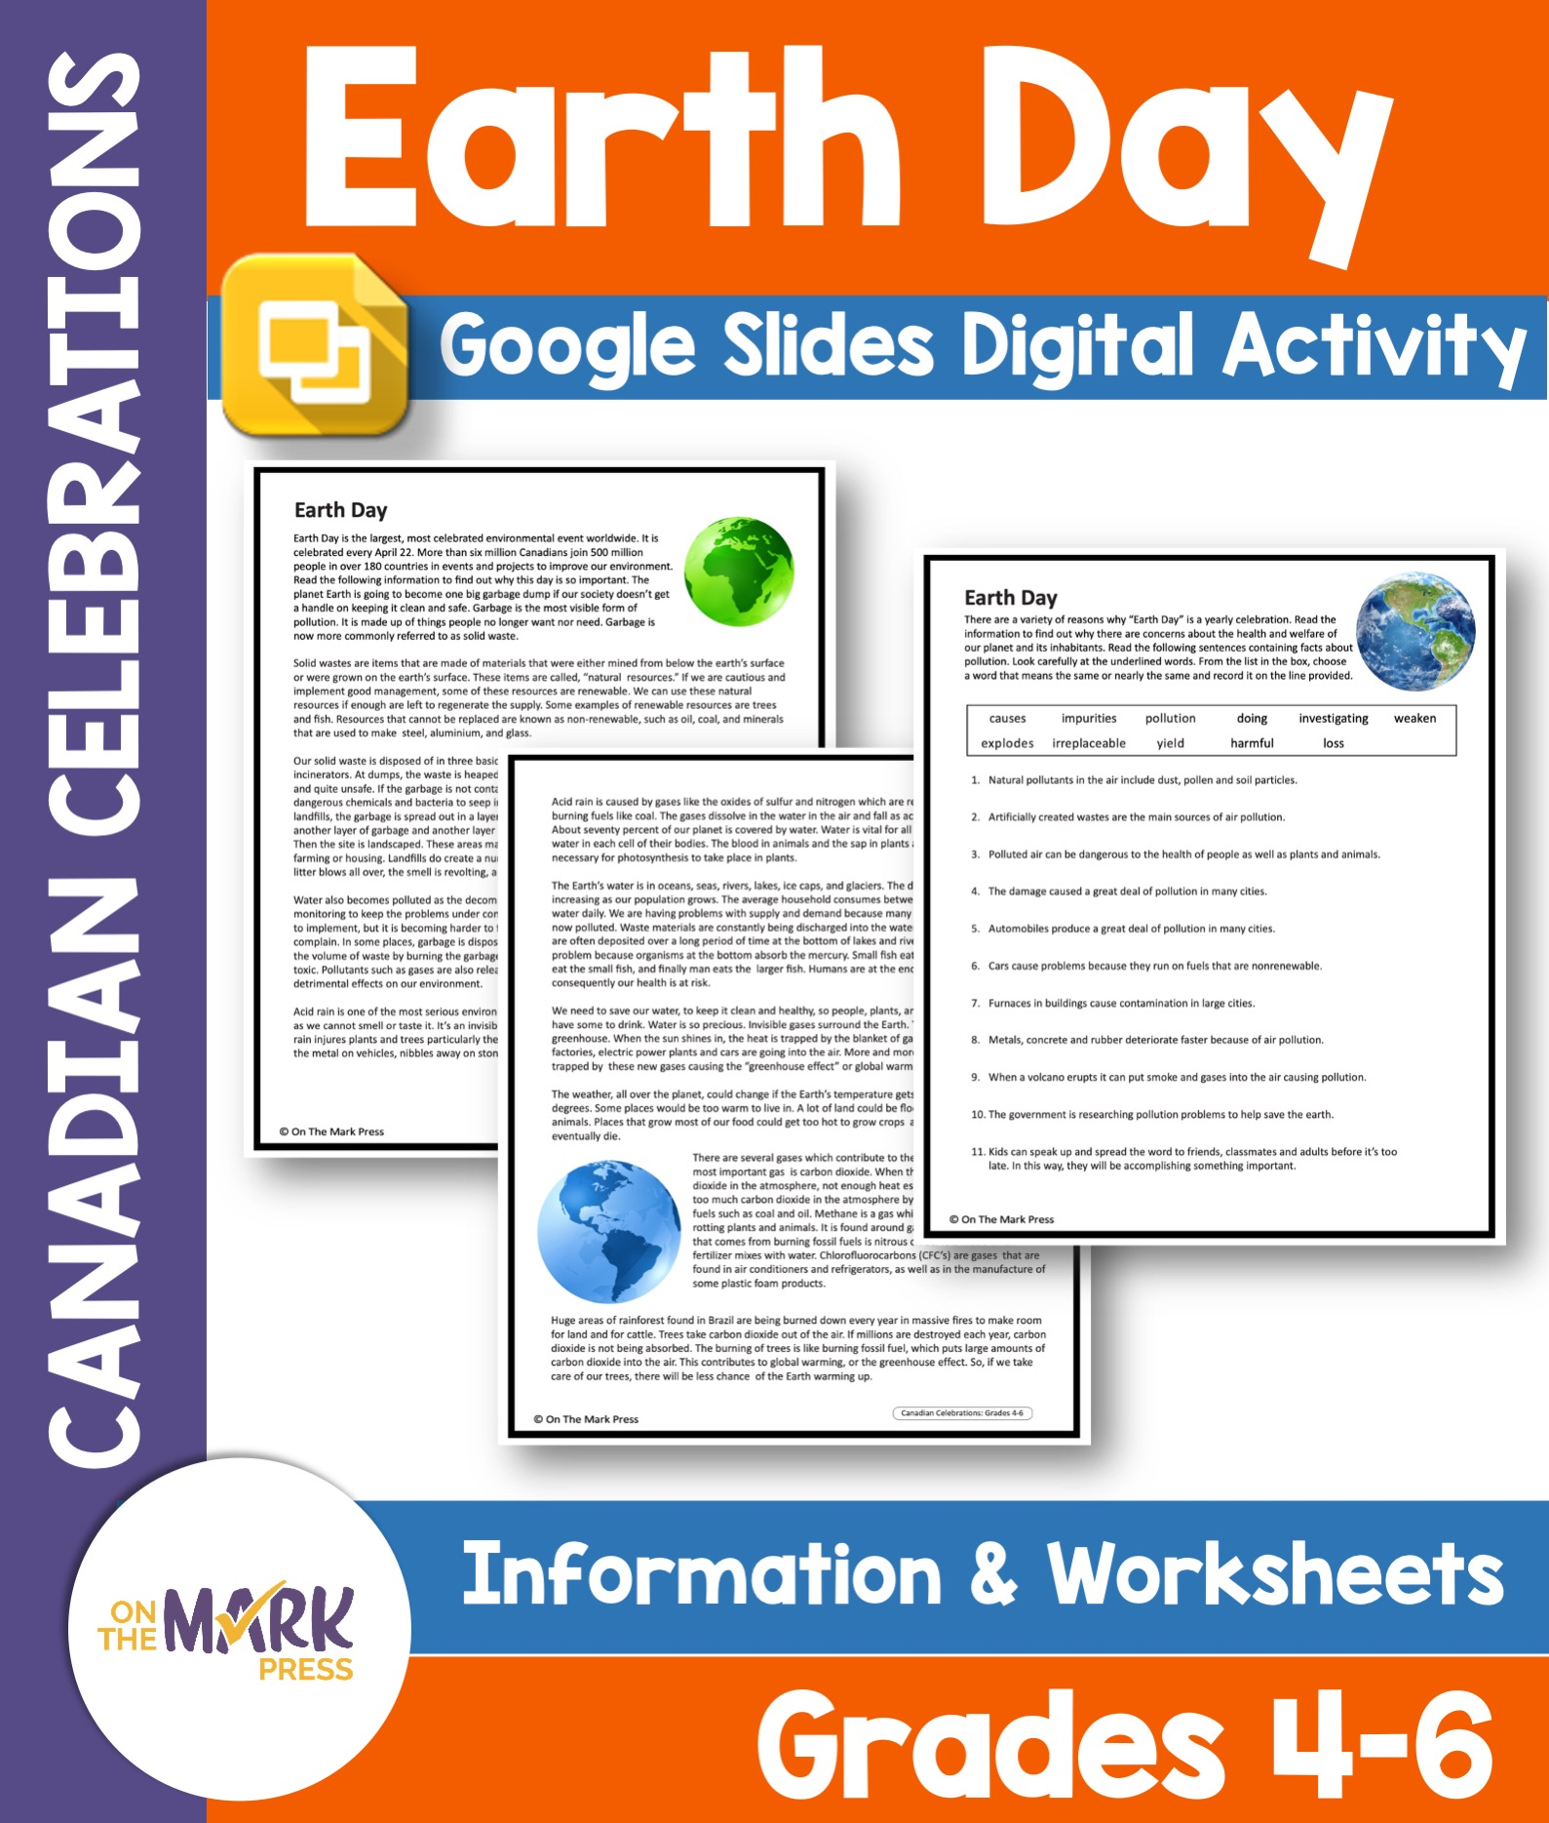

Slide 2
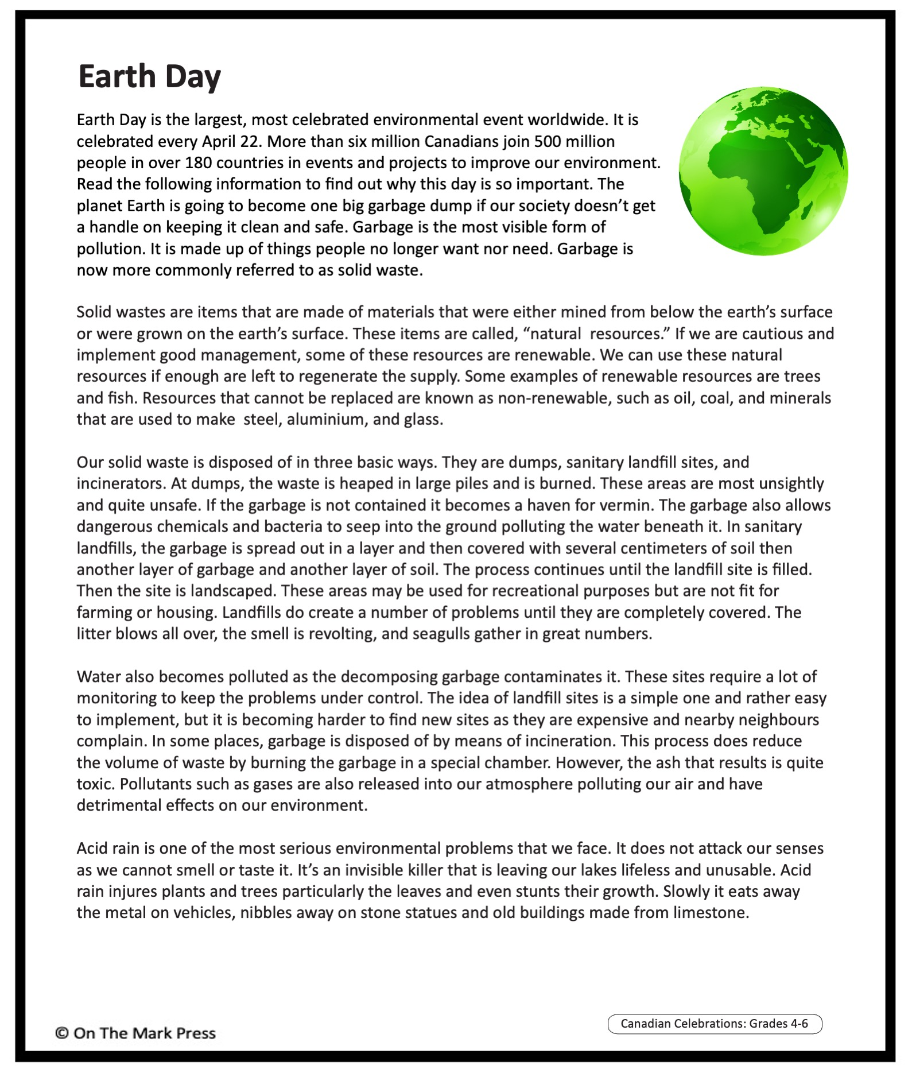

Slide 3
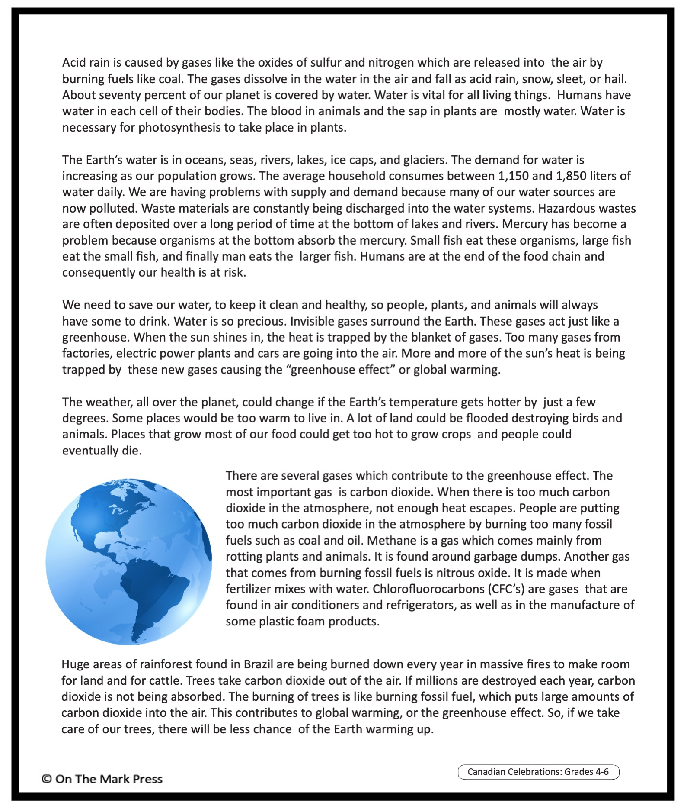

Slide 4


Earth Day
There are a variety of reasons why “Earth Day” is a yearly celebration. Read the information to find out why there are concerns about the health and welfare of our planet and its inhabitants. Read the following sentences containing facts about pollution. Look carefully at the underlined words. From the list in the box, choose a word that means the same or nearly the same and record it on the line provided.
causes | impurities | pollution | doing | investigating | weaken
explodes | irreplaceable | yield | harmful | loss
Natural pollutants in the air include dust, pollen and soil particles.
Artificially created wastes are the main sources of air pollution.
Polluted air can be dangerous to the health of people as well as plants and animals.
The damage caused a great deal of pollution in many cities.
Automobiles produce a great deal of pollution in many cities.
Cars cause problems because they run on fuels that are nonrenewable.
Furnaces in buildings cause contamination in large cities.
Metals, concrete and rubber deteriorate faster because of air pollution.
When a volcano erupts it can put smoke and gases into the air causing pollution.
The government is researching pollution problems to help save the earth.
Kids can speak up and spread the word to friends, classmates and adults before it’s too late. In this way, they will be accomplishing something important.

