Slide 1
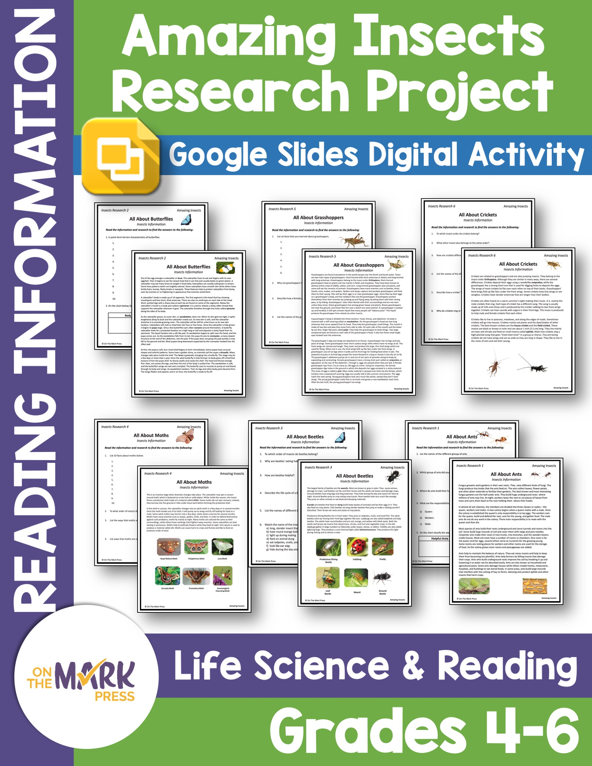

Slide 2
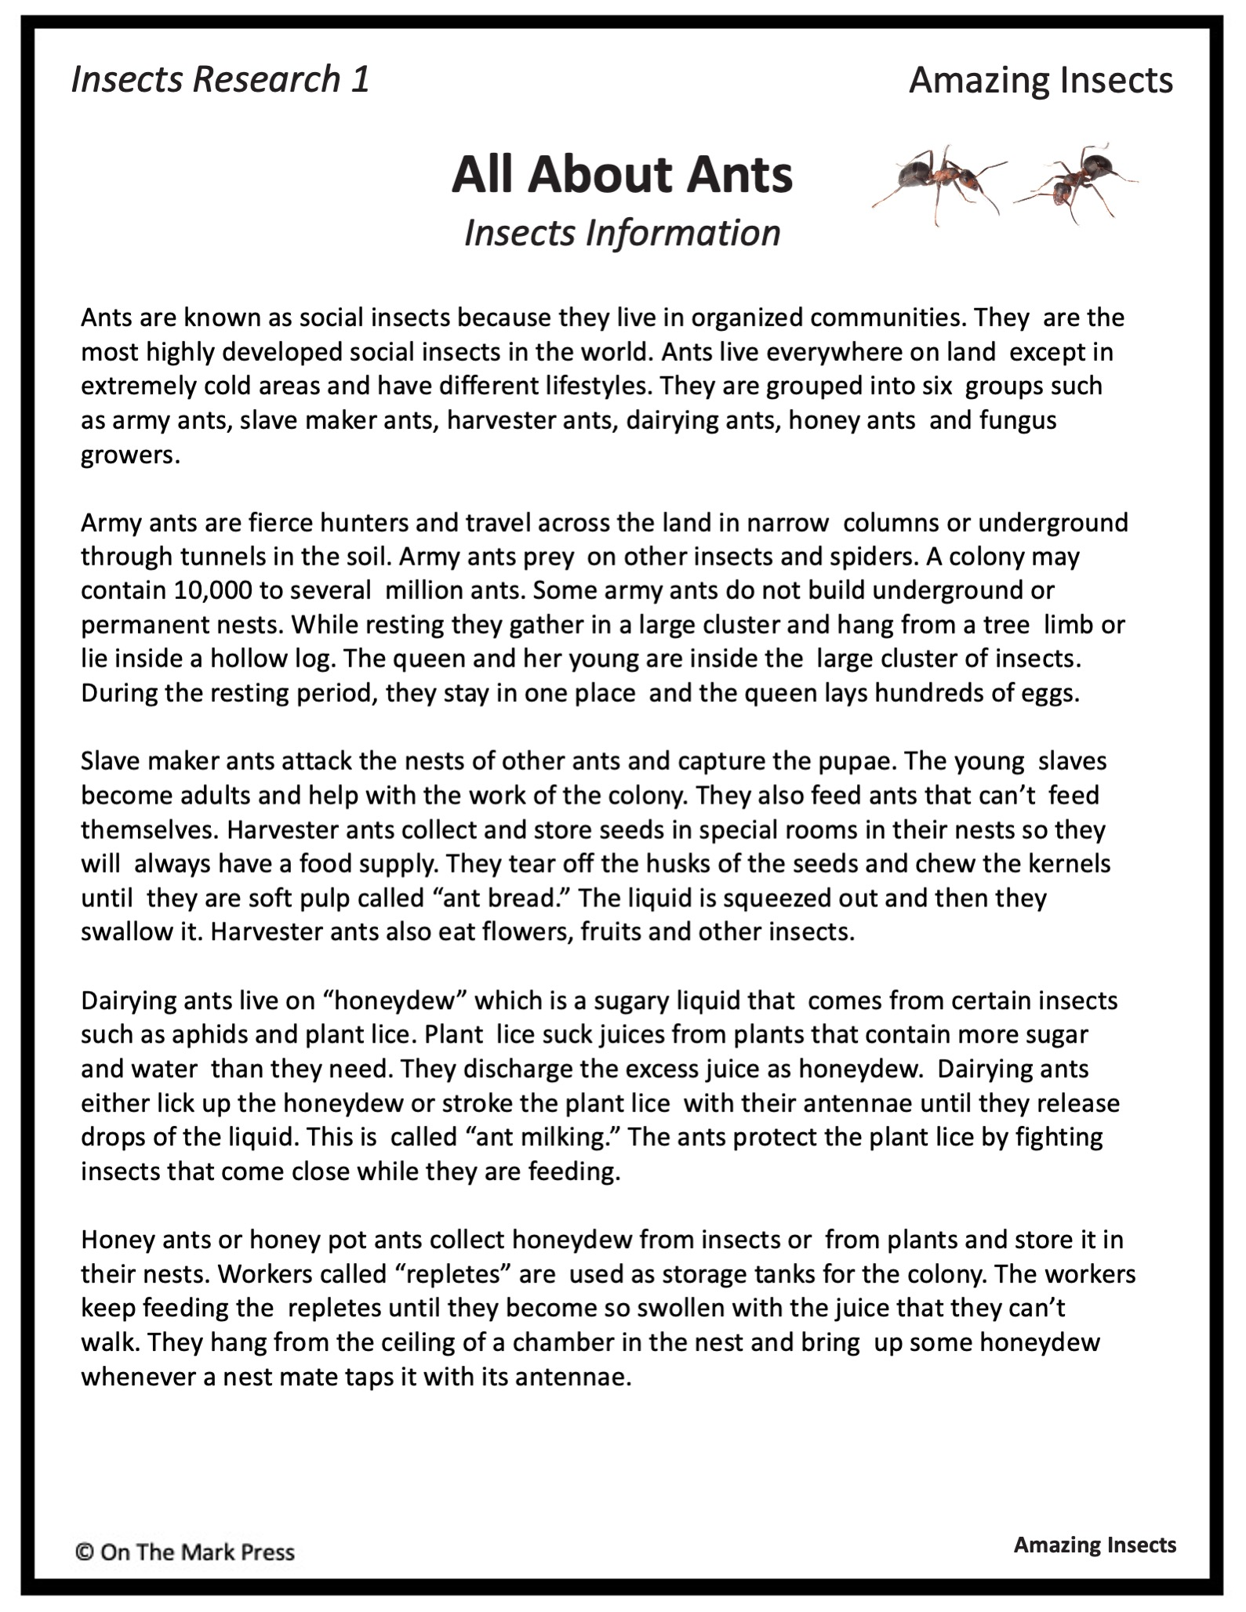

Slide 3
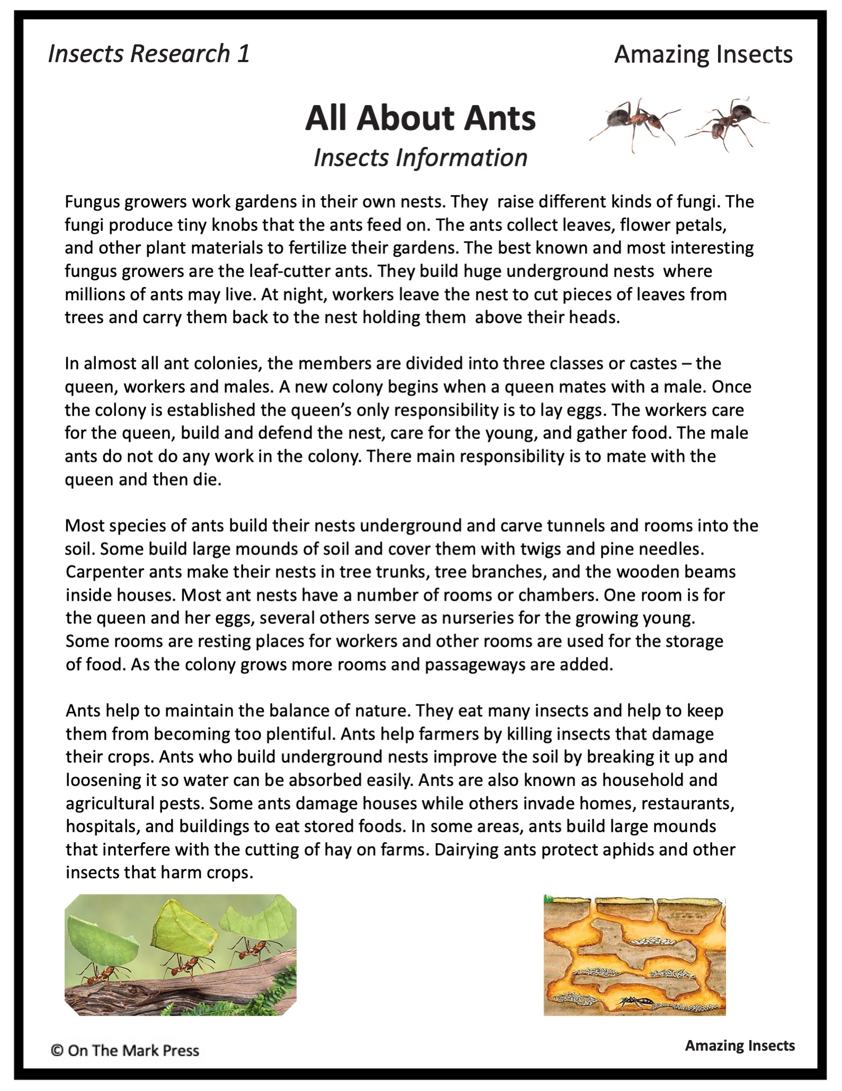

Slide 4

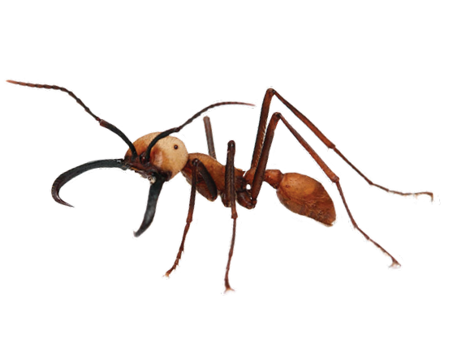
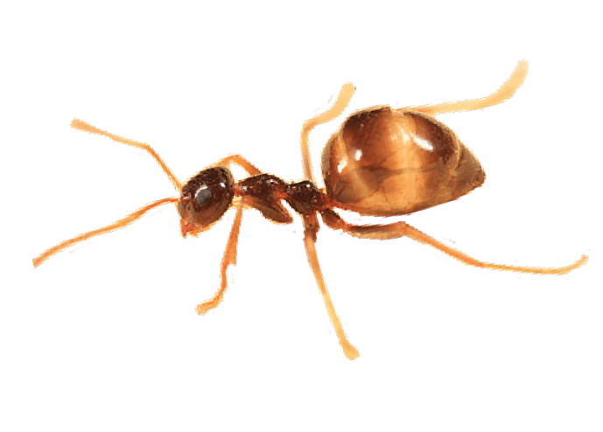
Insects Research 1
Amazing Insects
All About Ants
Insects Information
Read the information and research to find the answers to the following:
List the names of the different groups of ants.
Which group of ants did you find the most interesting? Explain why.
Where do ants build their homes?
What are the responsibilities of each of the following ants in a colony?
    Queen:
    Workers:
    Male:
  On the chart classify the ways ants are harmful and helpful.
Helpful Ants | Harmful Ants
Amazing Insects

Slide 5
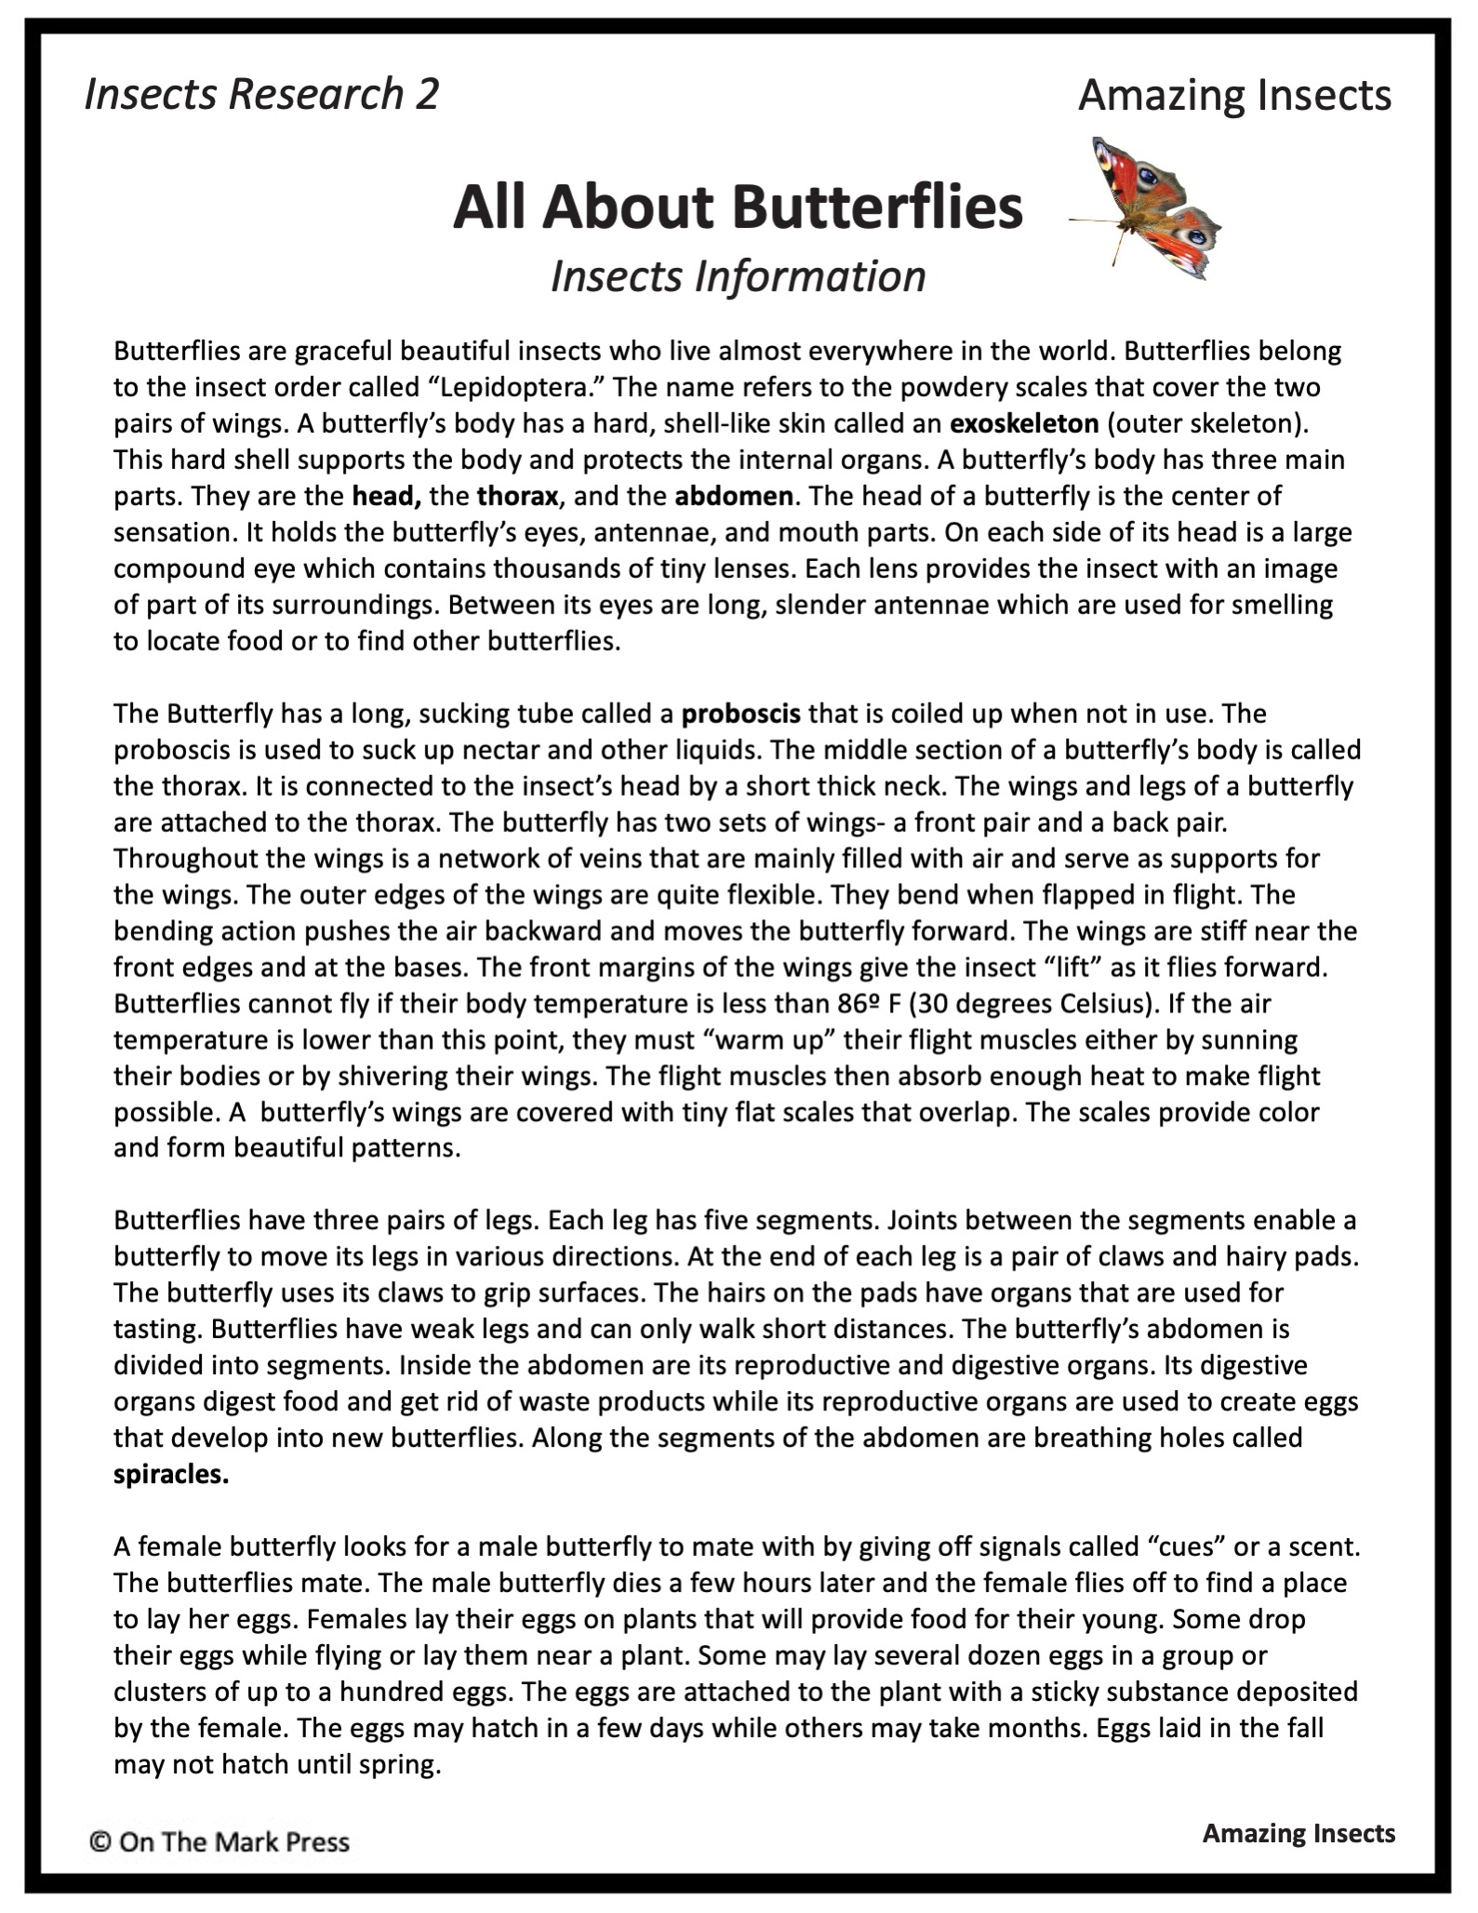

Slide 6
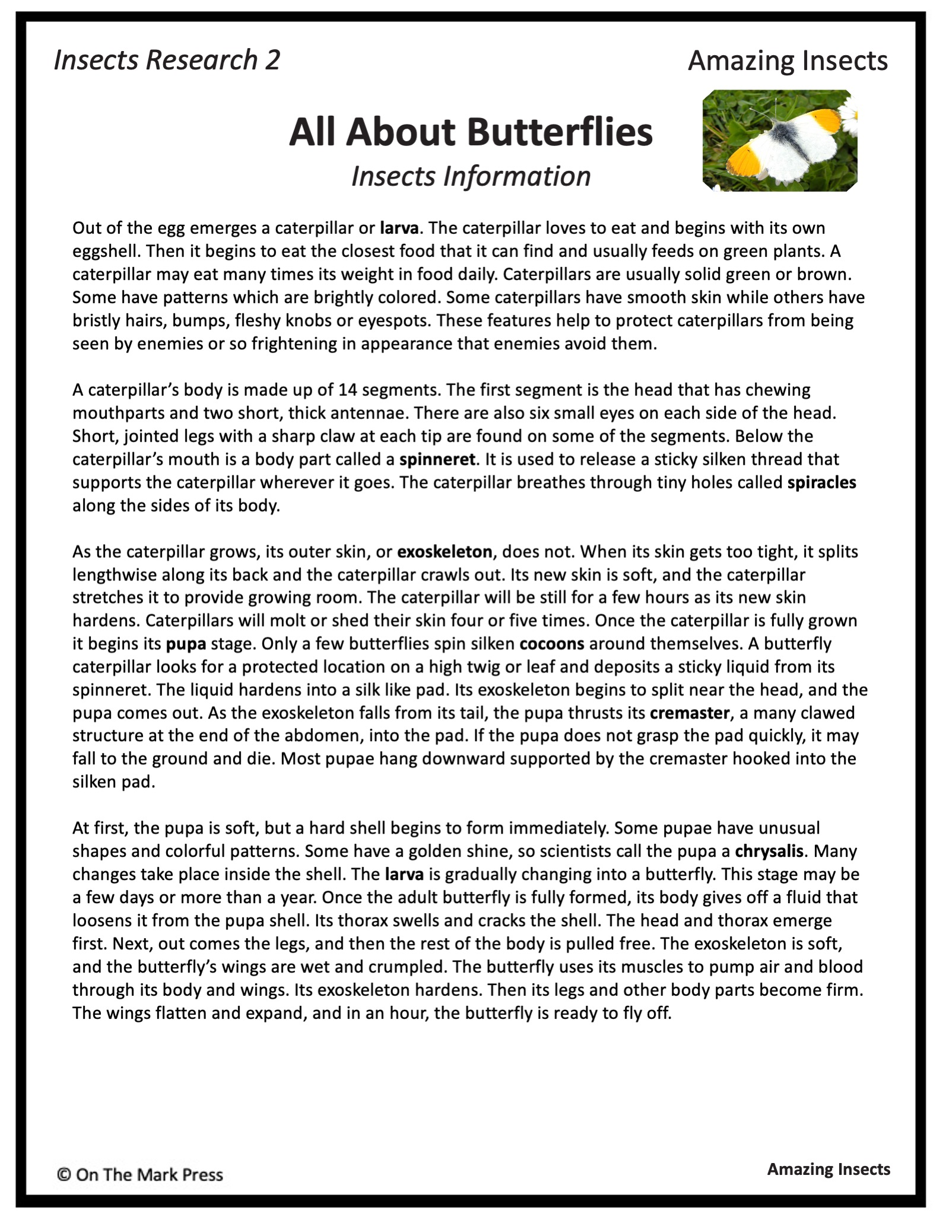

Slide 7
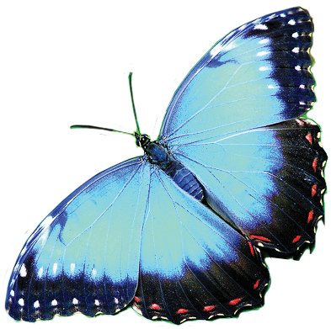
Insects Research 2
Amazing Insects
All About Butterflies
Insects Information
Read the information and research to find the answers to the following:
1. In point form list ten characteristics of butterflies.
2. On the chart below, list each body part of a butterfly and its function(s).
Body Part | Function
Amazing Insects

Slide 8
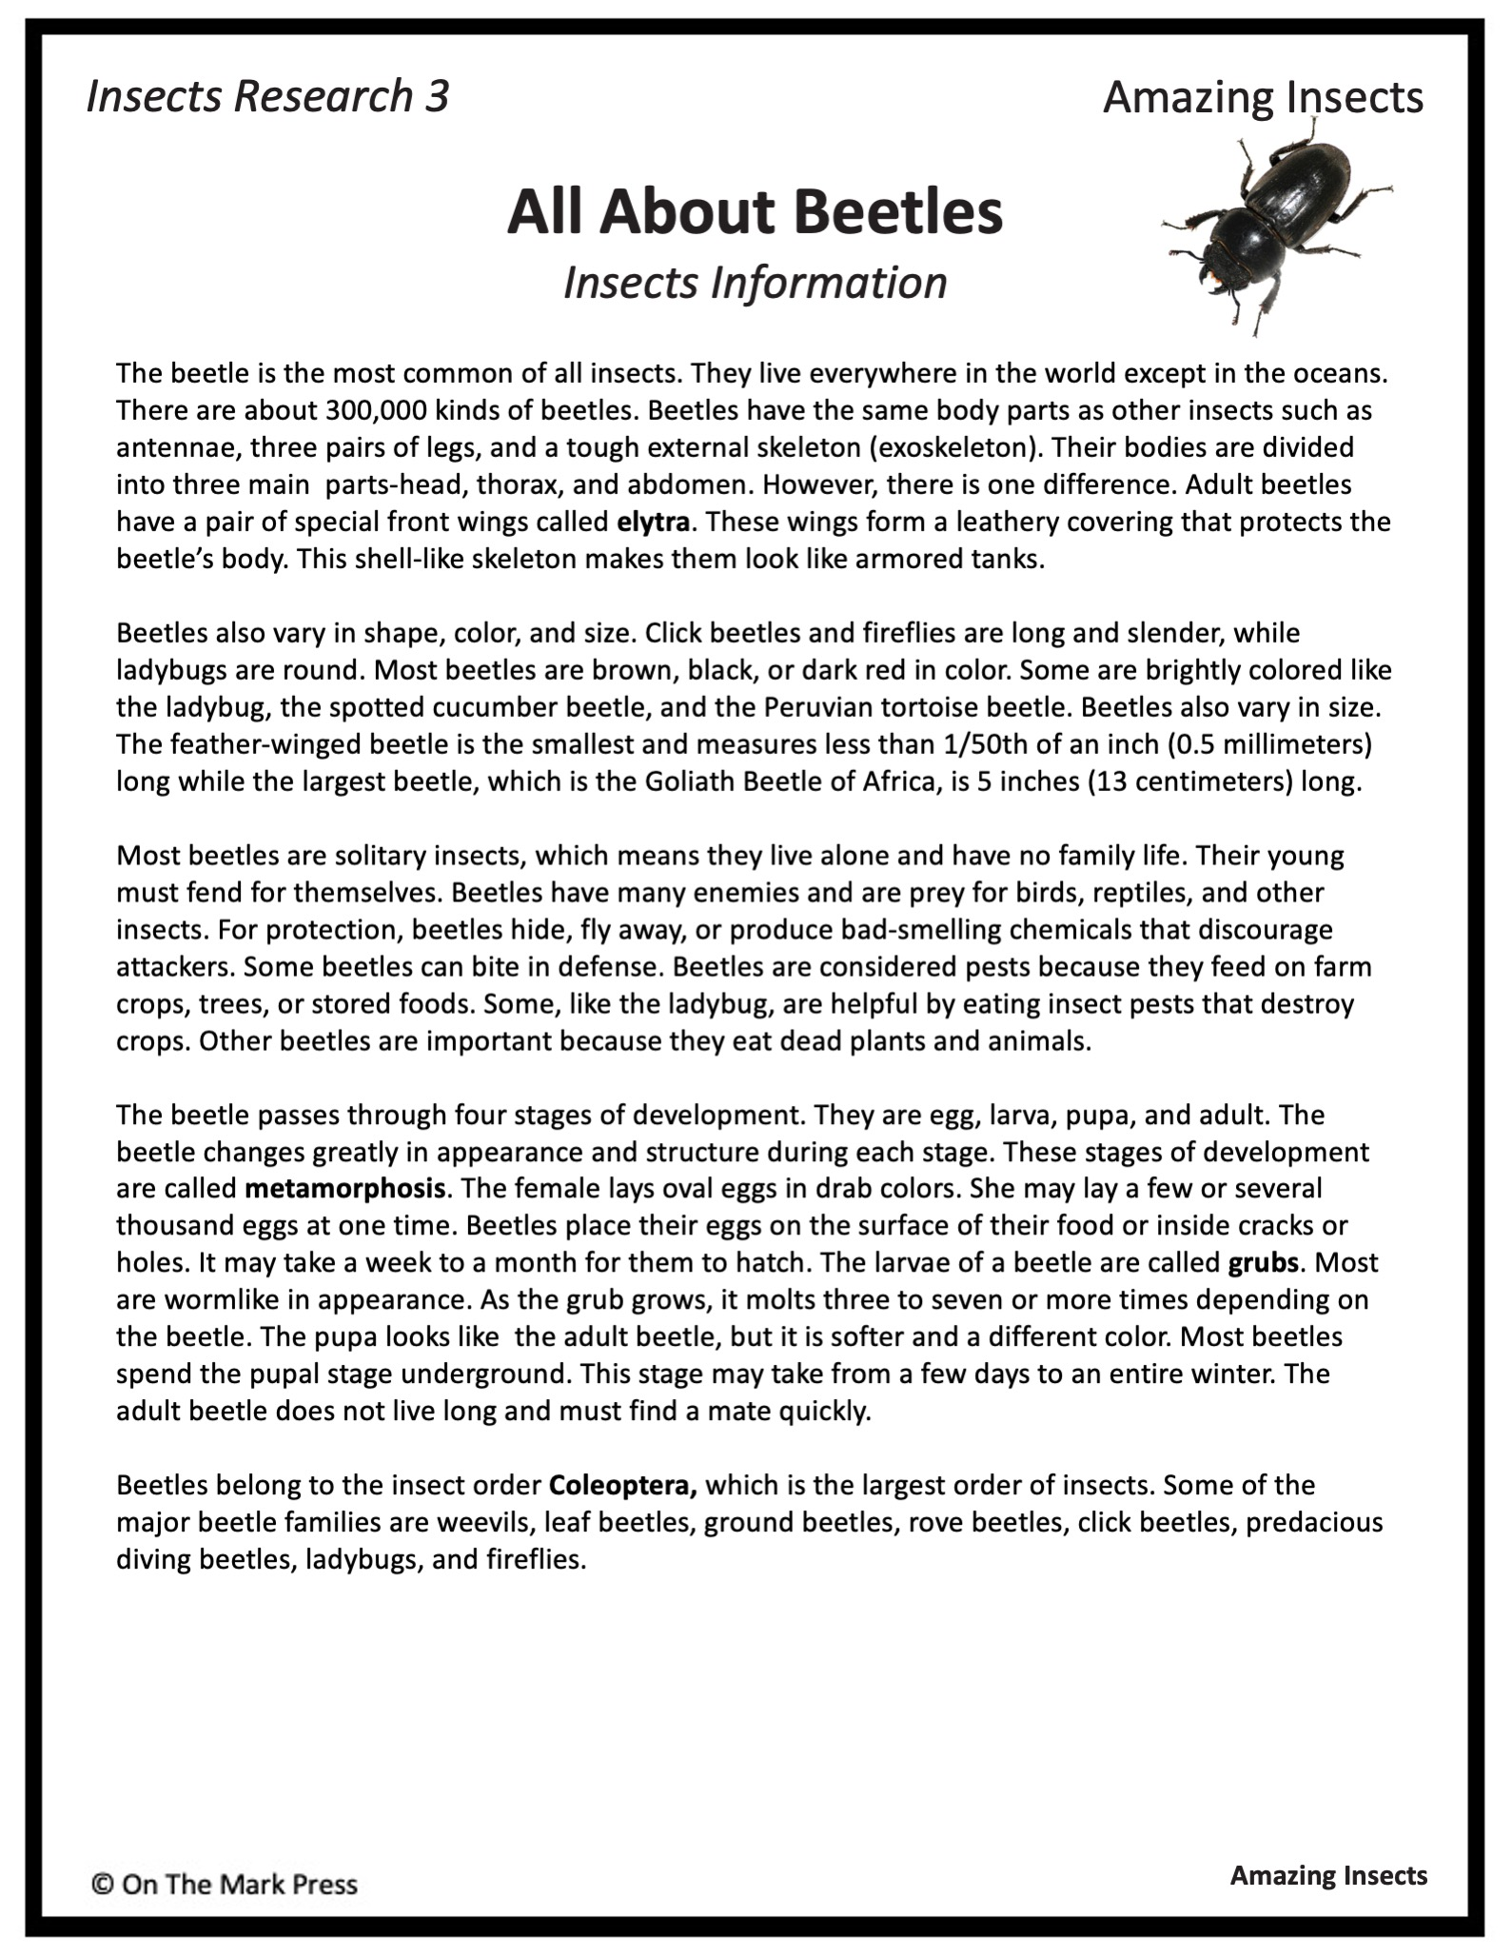

Slide 9
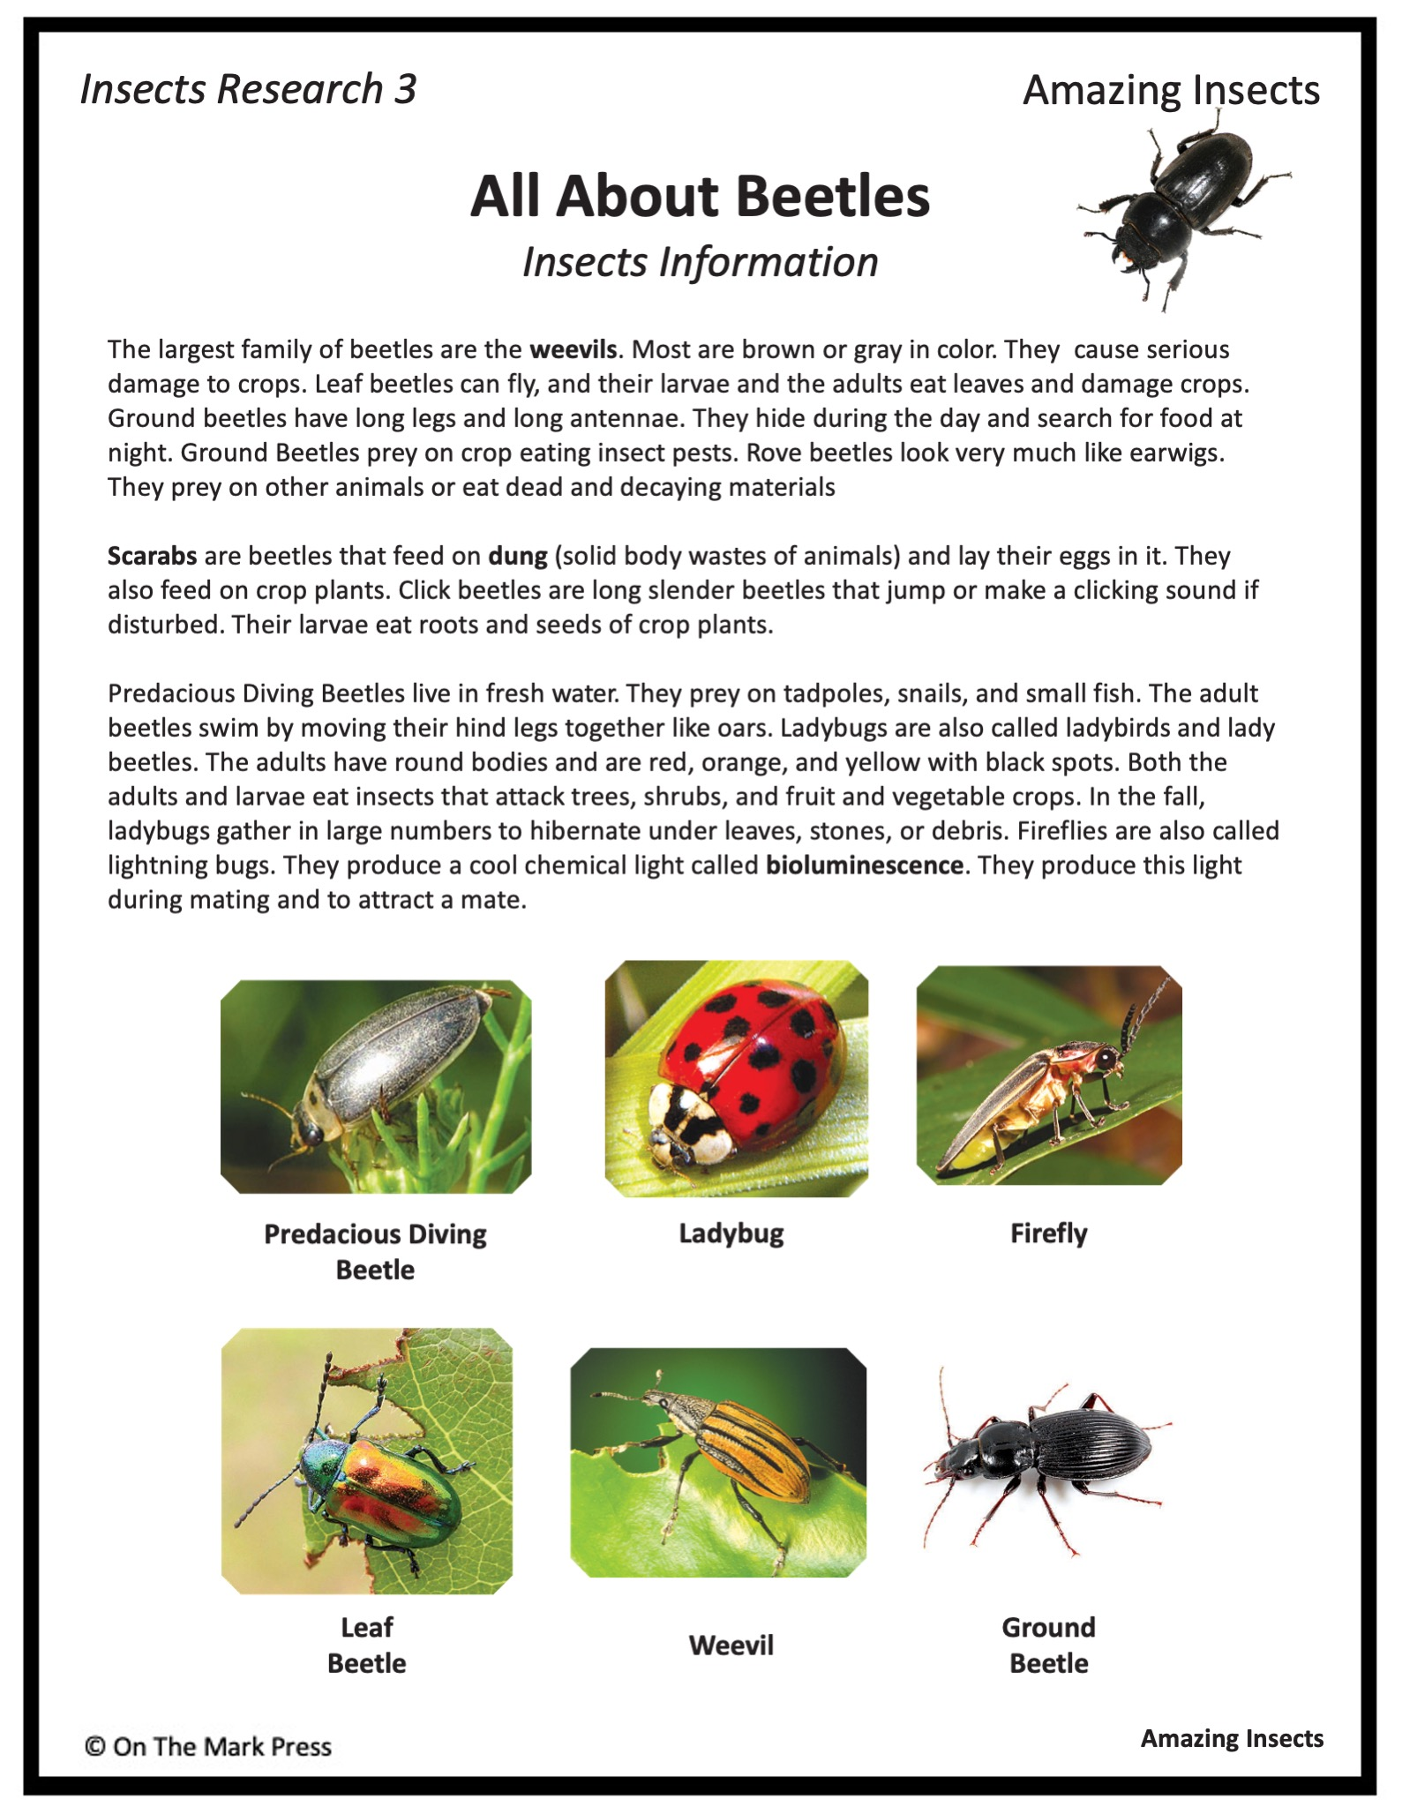

Slide 10
Insects Research 3
Amazing Insects
All About Beetles
Insects Information
Read the information and research to find the answers to the following:
To which order of insects do beetles belong?
Why are beetles’ eating habits harmful?
How are beetles helpful?
Describe the life cycle of a beetle.
List the names of different types of beetles found in the world.
Match the name of the insect to each clue.
      long, slender insect that jumps and clicks
      have round orange bodies with black spots
      light up during mating
      feed on animal dung
      eat tadpoles, snails, and some small fish
      look like ear wigs
      hide during the day and come out at night
A)
B)
C)
D)
E)
F)
G)
Amazing Insects

Slide 11
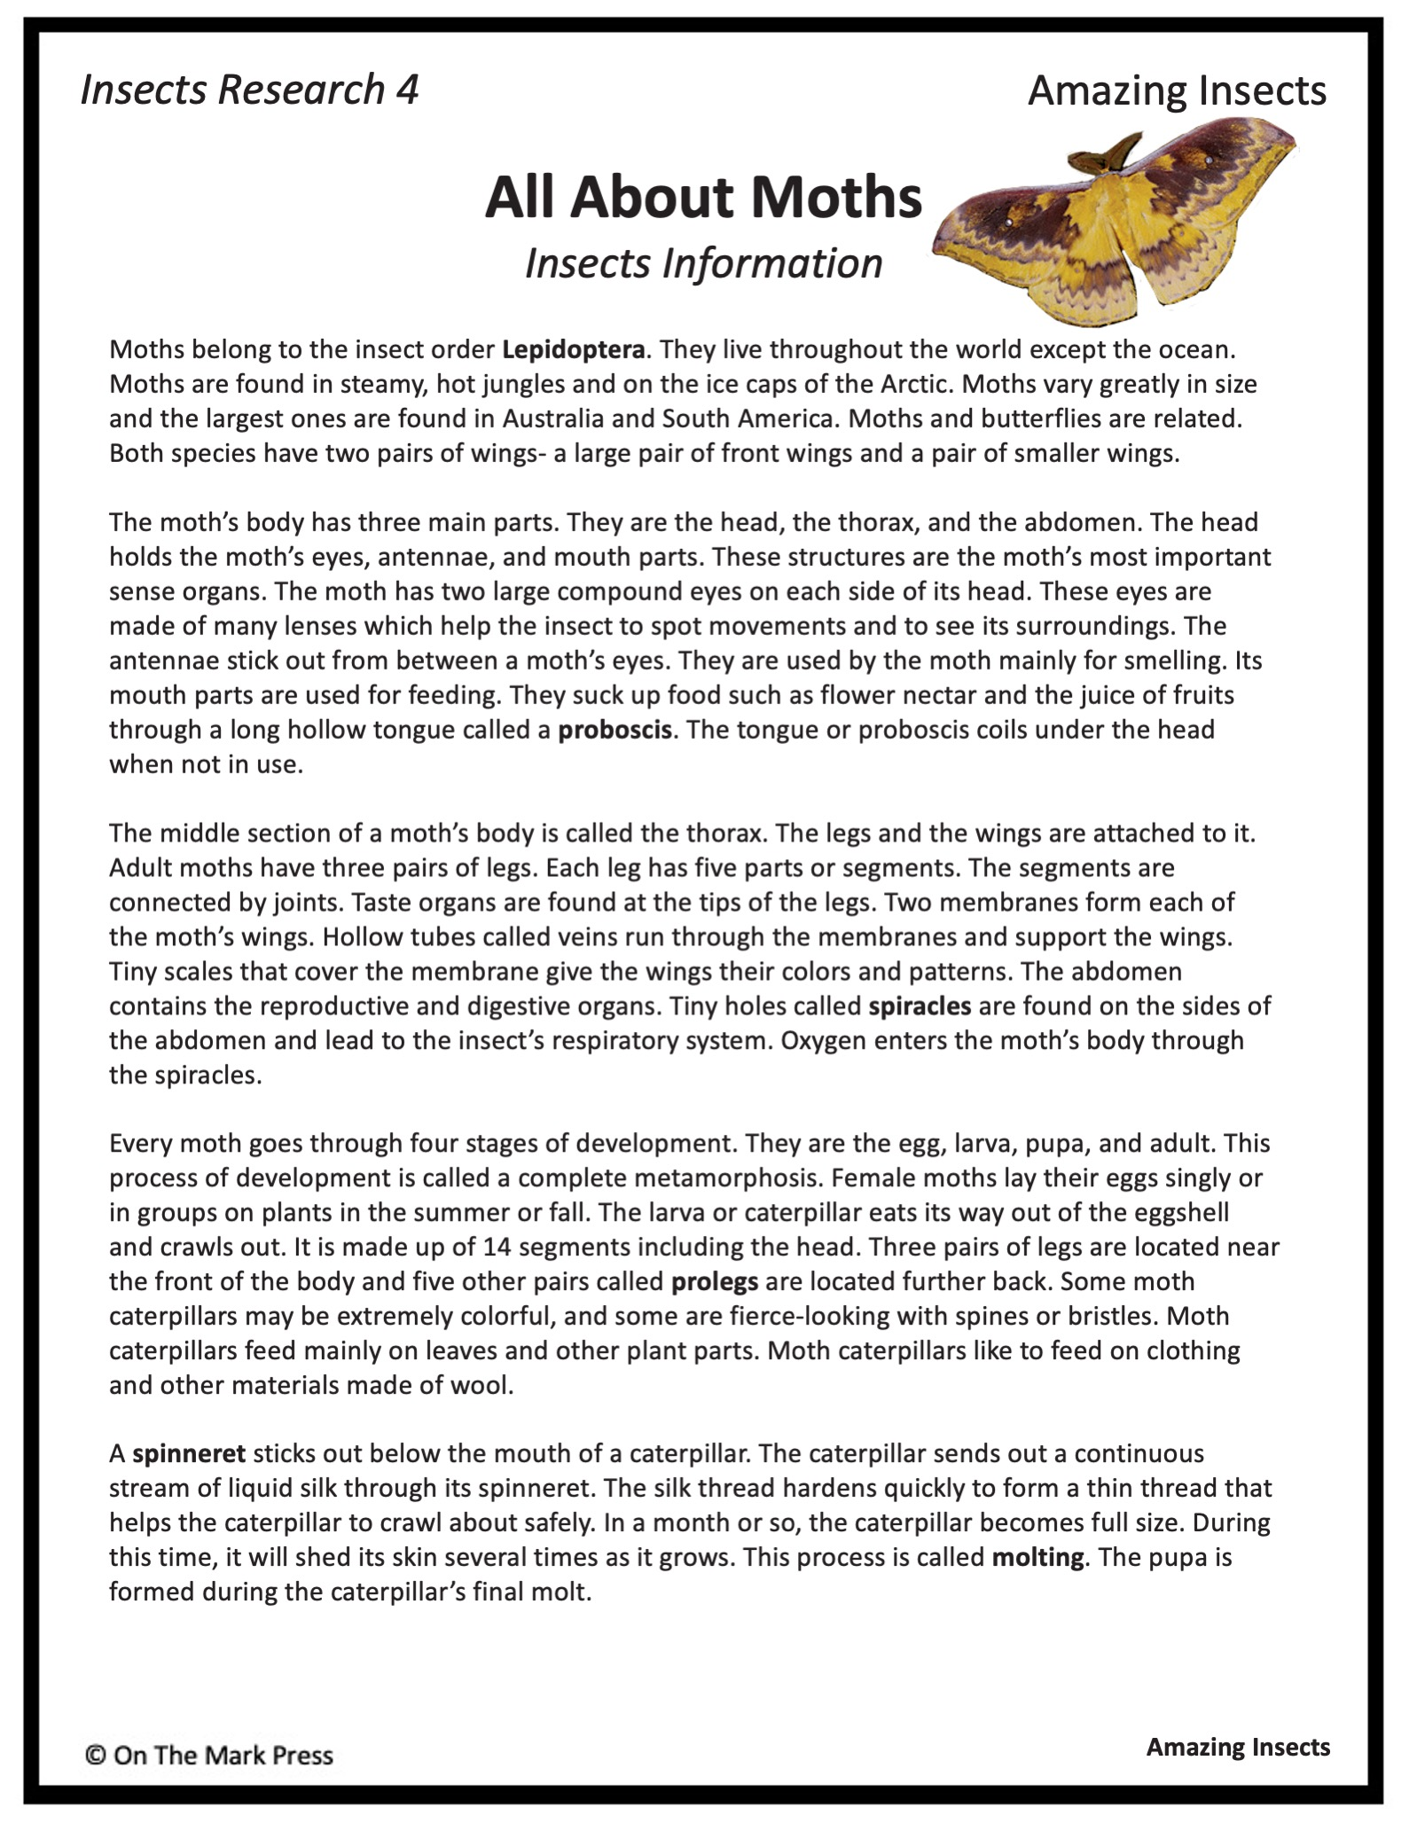

Slide 12
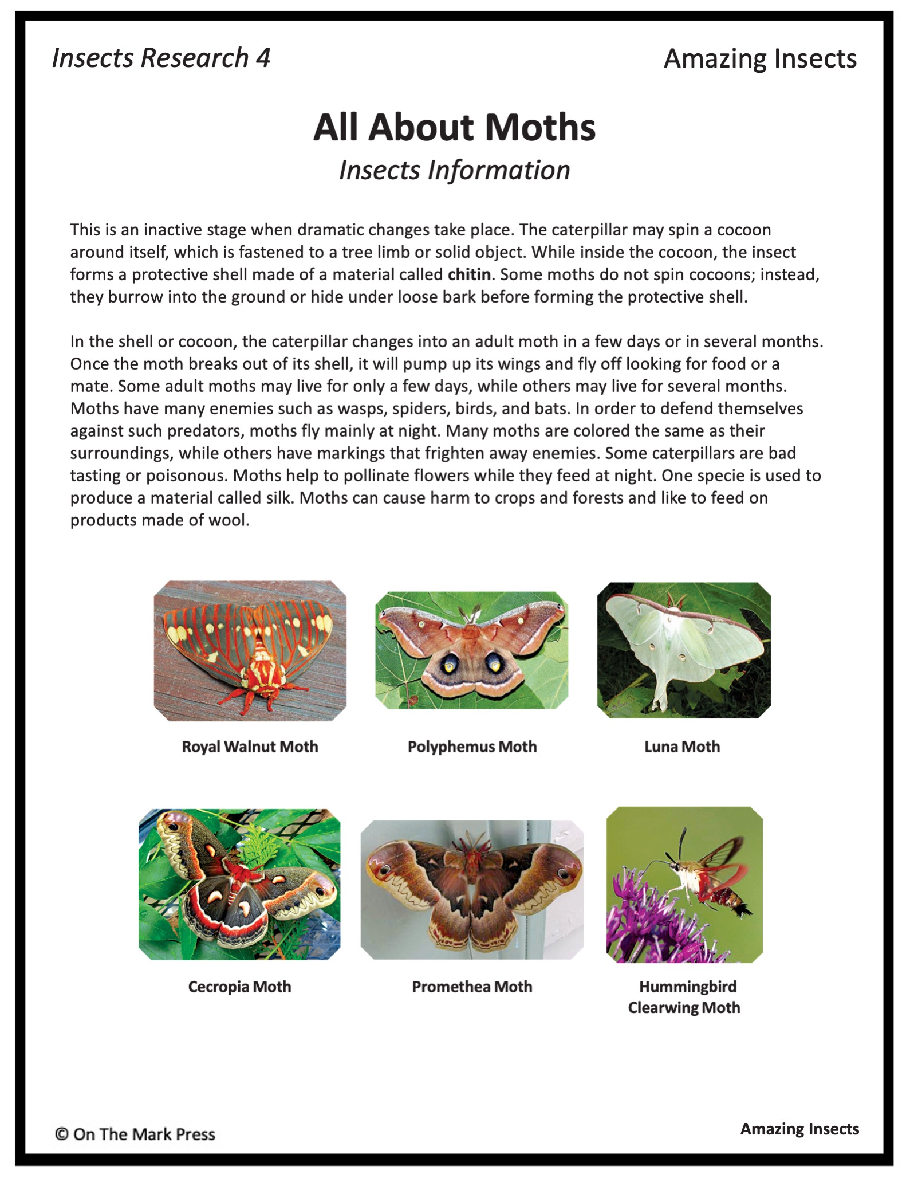

Slide 13
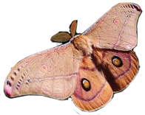
Insects Research 4
Amazing Insects
All About Moths
Insects Information
Read the information and research to find the answers to the following:
List 10 facts about moths below.
To what order of insects do moths belong?
List the ways that moths are different from butterflies.
List ways that moths are similar to butterflies.
Amazing Insects

Slide 14
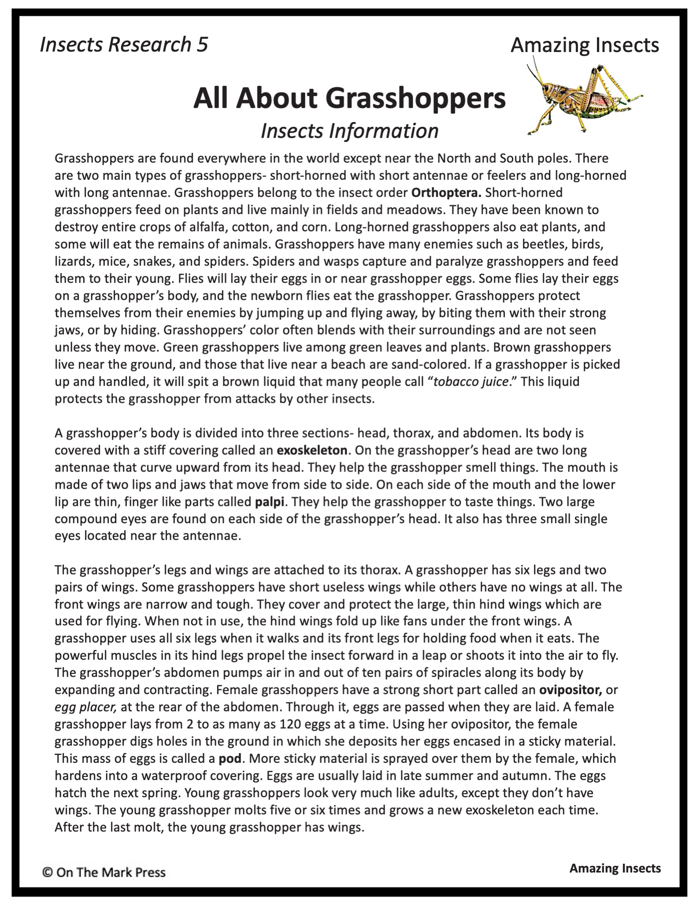

Slide 15
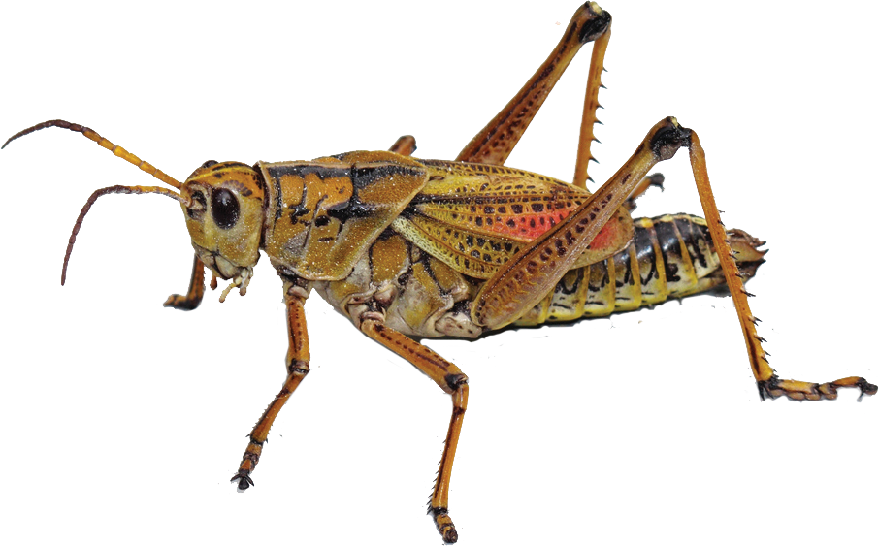
Insects Research 5
Amazing Insects
All About Grasshoppers
Insects Information
Read the information and research to find the answers to the following:
List six facts that you learned about grasshoppers.
Why are grasshoppers harmful insects?
Describe how a female grasshopper lays her eggs.
List the names of the grasshopper’s enemies.
Amazing Insects

Slide 16
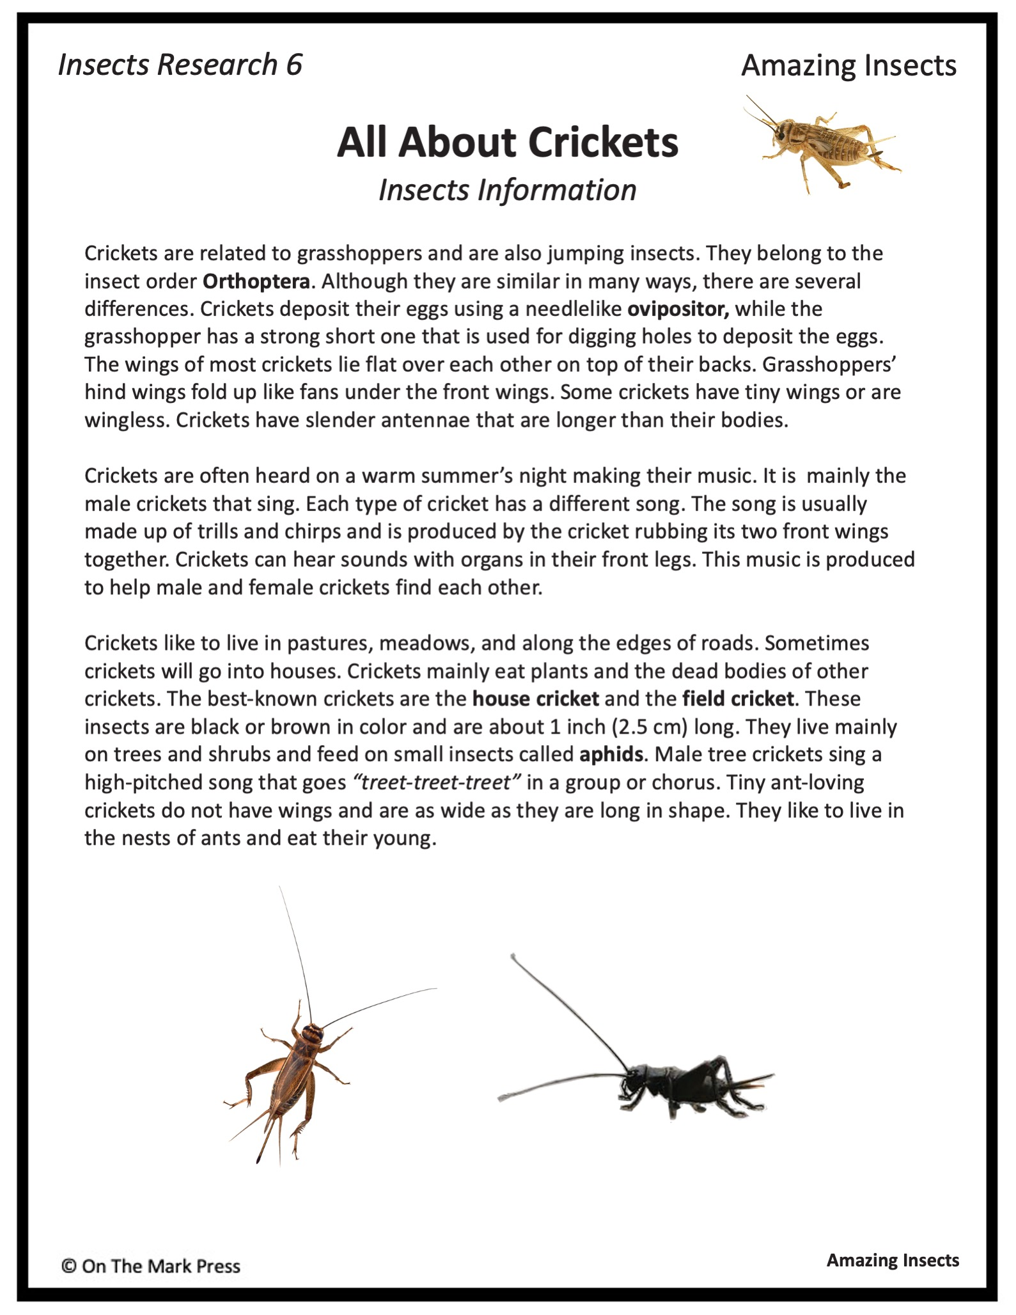

Slide 17
Insects Research 6
Amazing Insects
All About Crickets
Insects Information
Read the information and research to find the answers to the following:
To which insect order do crickets belong?
What other insect also belongs to the same order?
How are crickets different from grasshoppers?
List the names of the different types of crickets.
Describe how a cricket “sings.”
Why do crickets sing or make a chirping noise?
Amazing Insects

