Slide 1







Health and Physical Education
Healthy
Eating
Understanding Key Nutrients
www.onthemarkcurriculum.com

Slide 2


Learning Objective:
Identify the key nutrients (fats, proteins, carbohydrates, water, vitamins, and minerals) provided by foods and beverages and explain their importance for health.
© On The Mark Curriculum OTM412-ON

Slide 3


What are
Nutrients?
Nutrients are substances in food that help us grow, stay healthy, and have energy.
Fuel for the Body!
Just like a car needs the right fuel to run, our bodies need the right nutrients to work their best!
© On The Mark Curriculum OTM412-ON

Slide 4

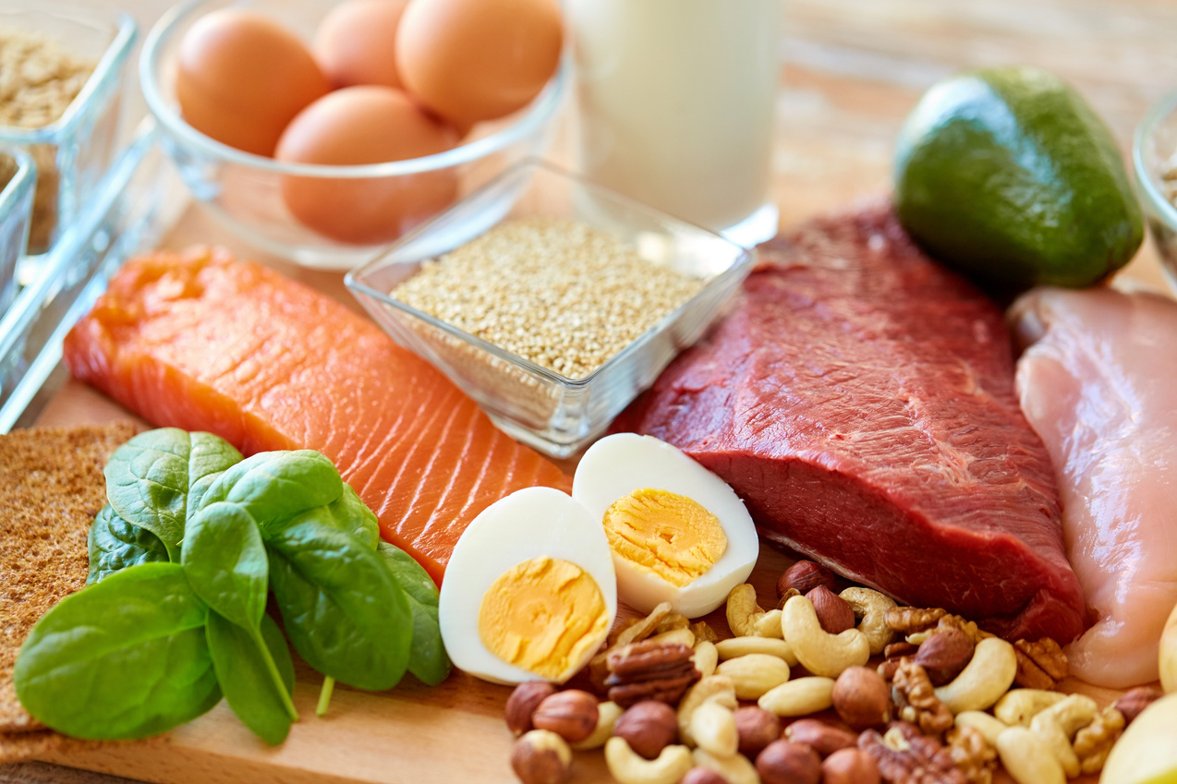
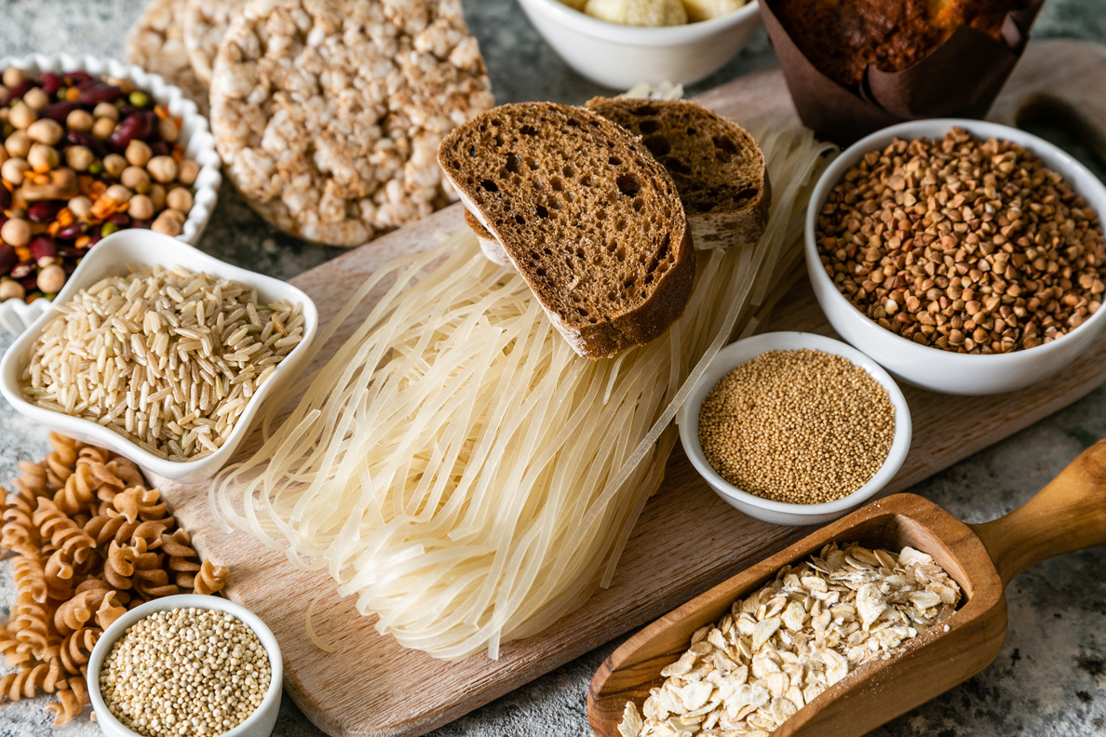


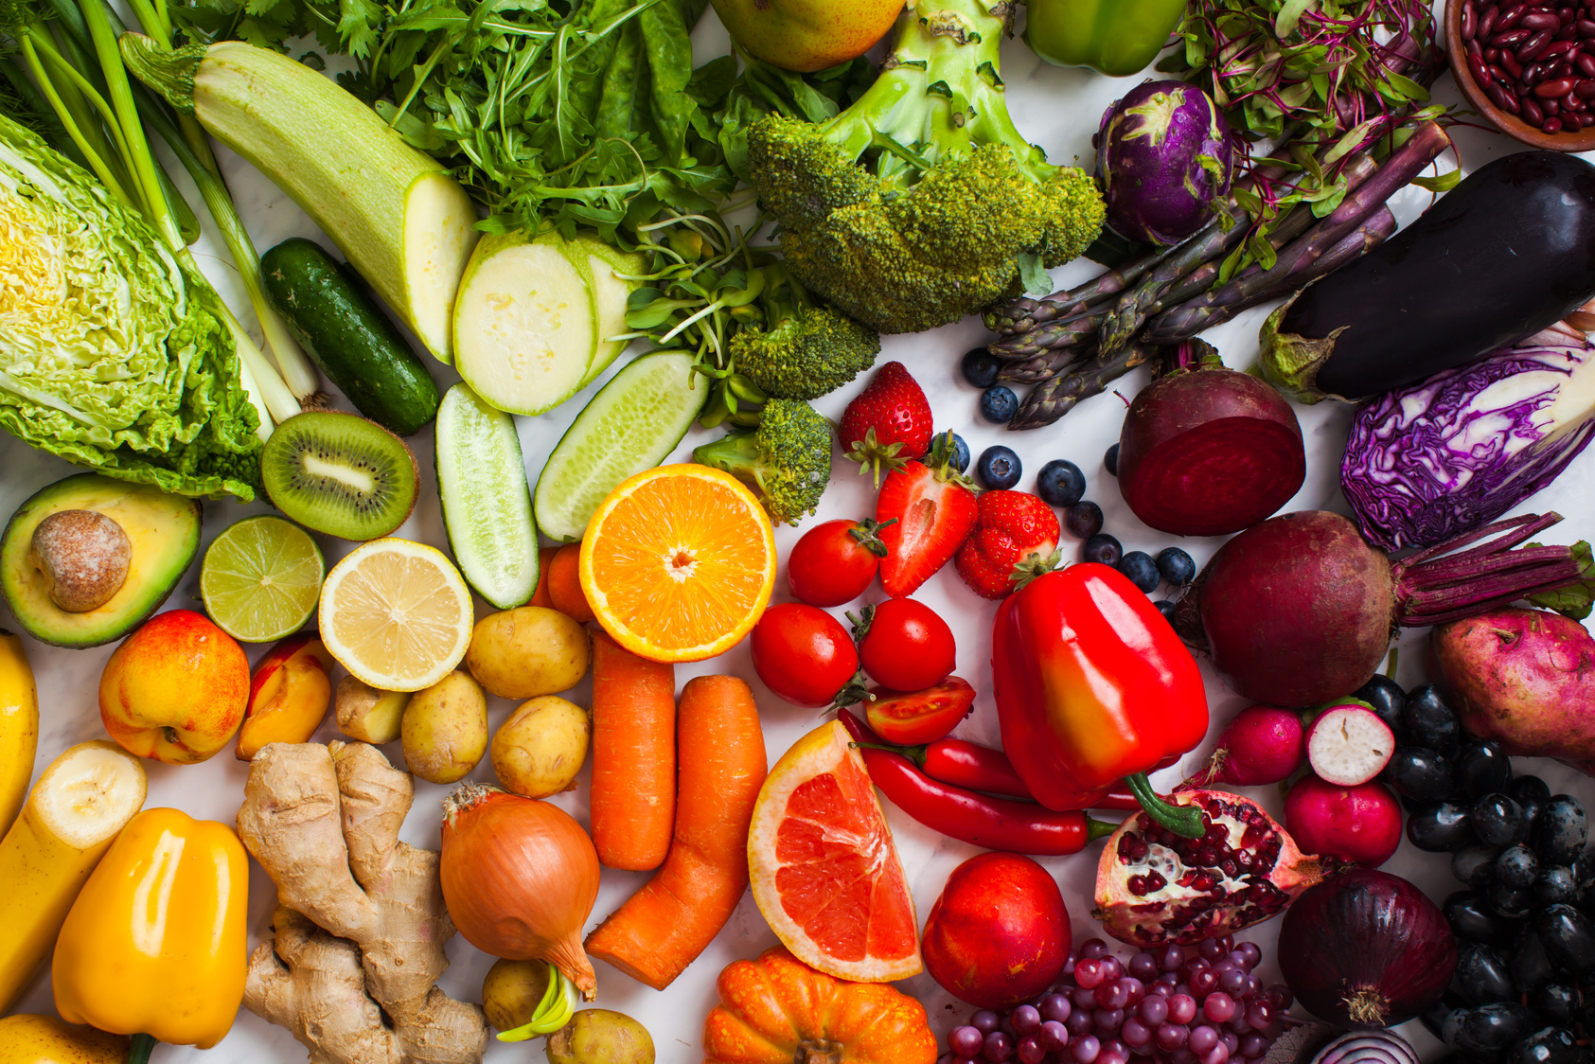
1 - Fats
2 - Proteins
3 - Carbohydrates
4 - Water
The Six
Key Nutrients
5 - Vitamins
6 - Minerals
© On The Mark Curriculum OTM412-ON

Slide 5



01
Fats
Fats give our body energy and help protect our organs. They also support brain function and help absorb certain vitamins.
Nuts
Avocados
Salmon
© On The Mark Curriculum OTM412-ON

Slide 6
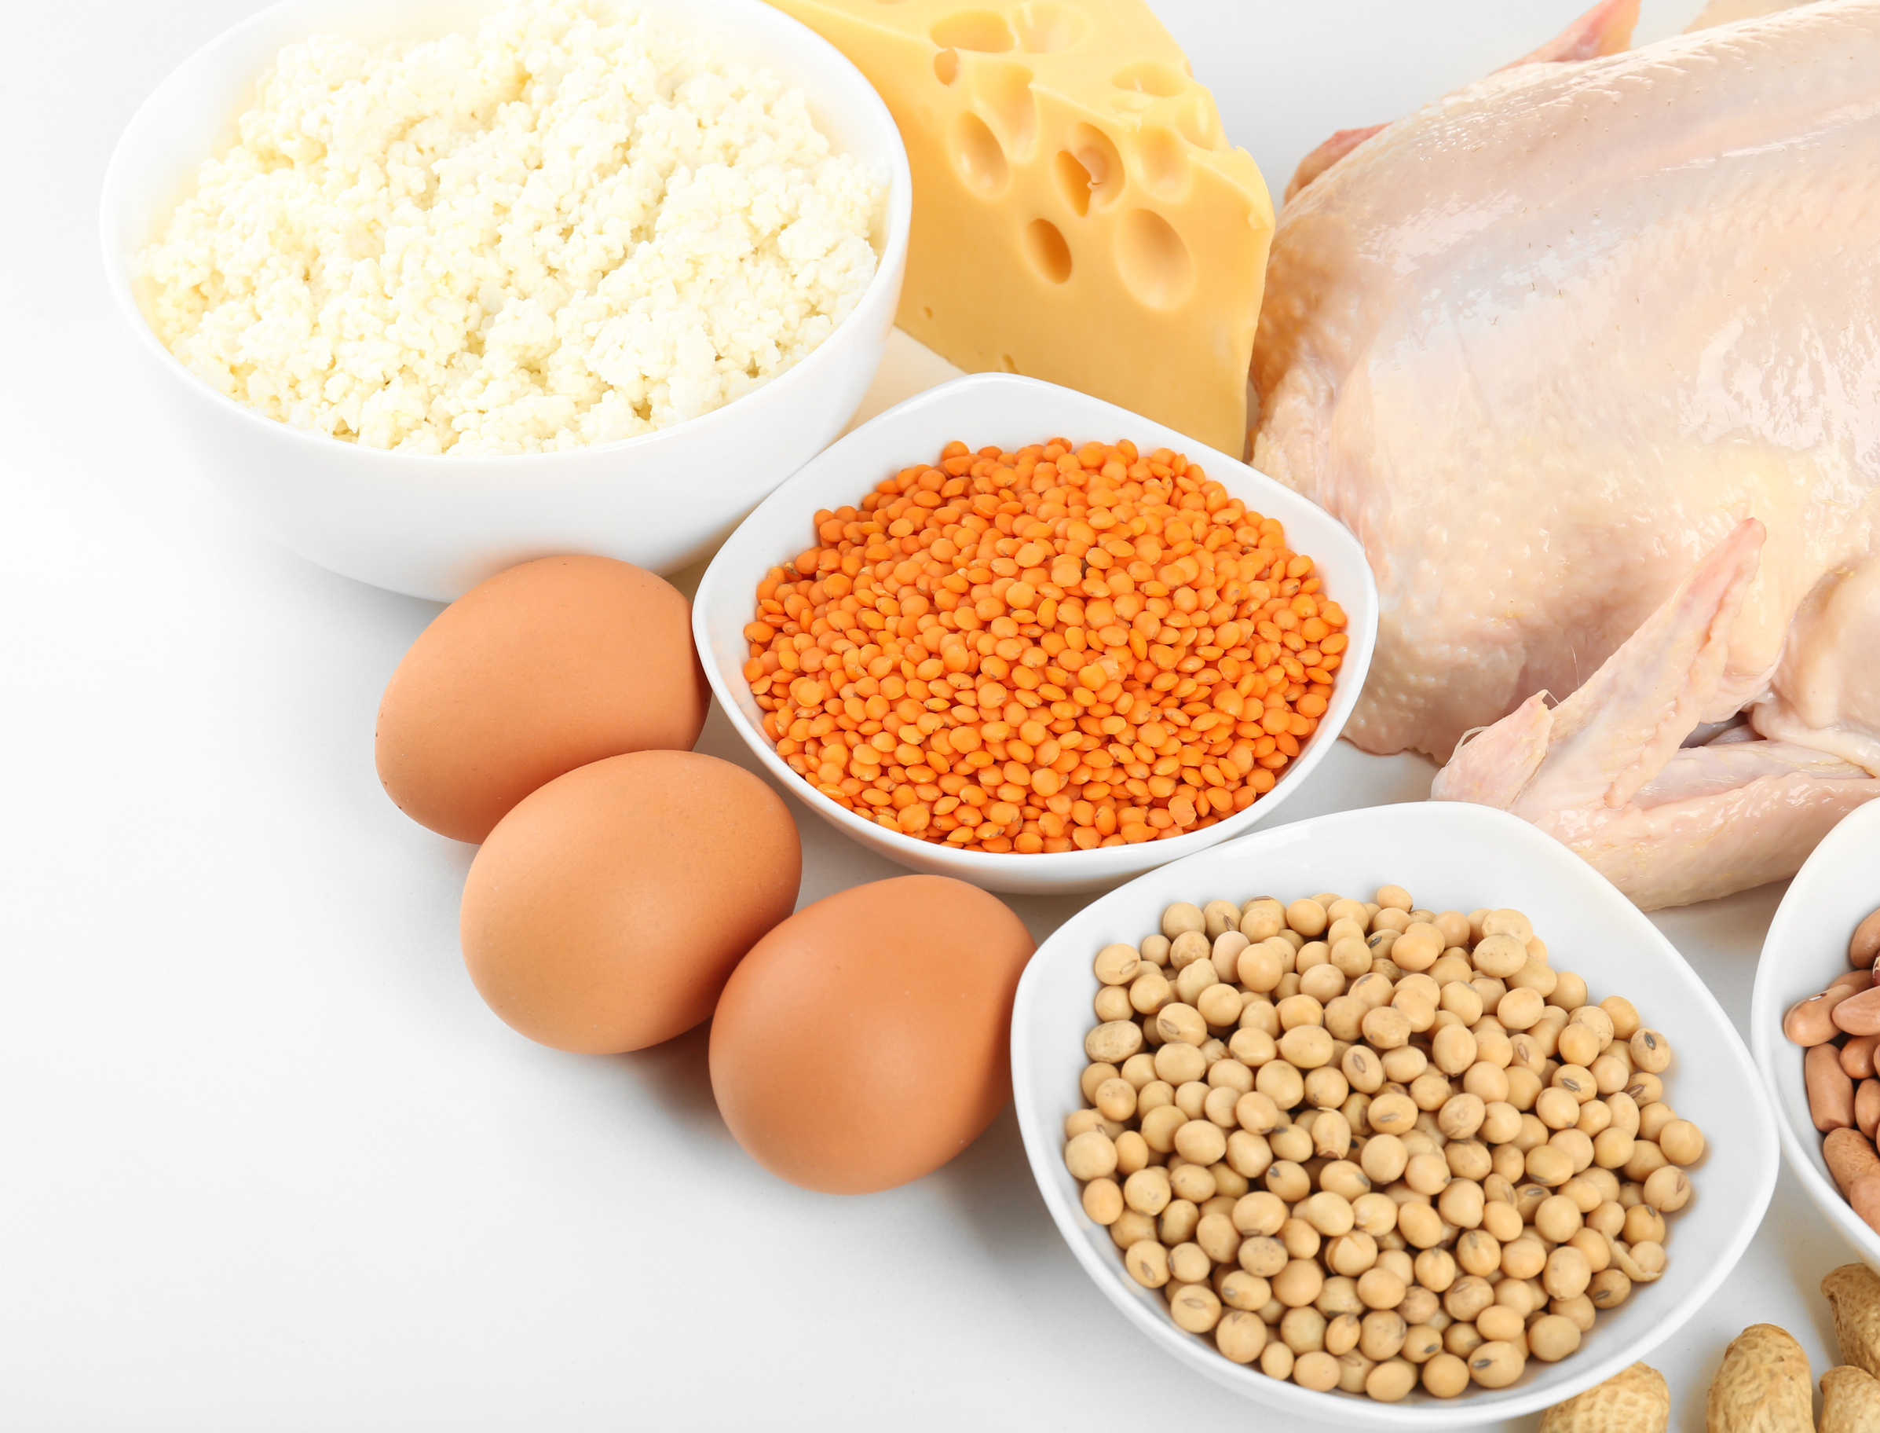
02
Proteins
Proteins help build and repair muscles, tissues, and skin. They also support the immune system and provide energy when needed.
Eggs
Chicken
Beans
© On The Mark Curriculum OTM412-ON

Slide 7
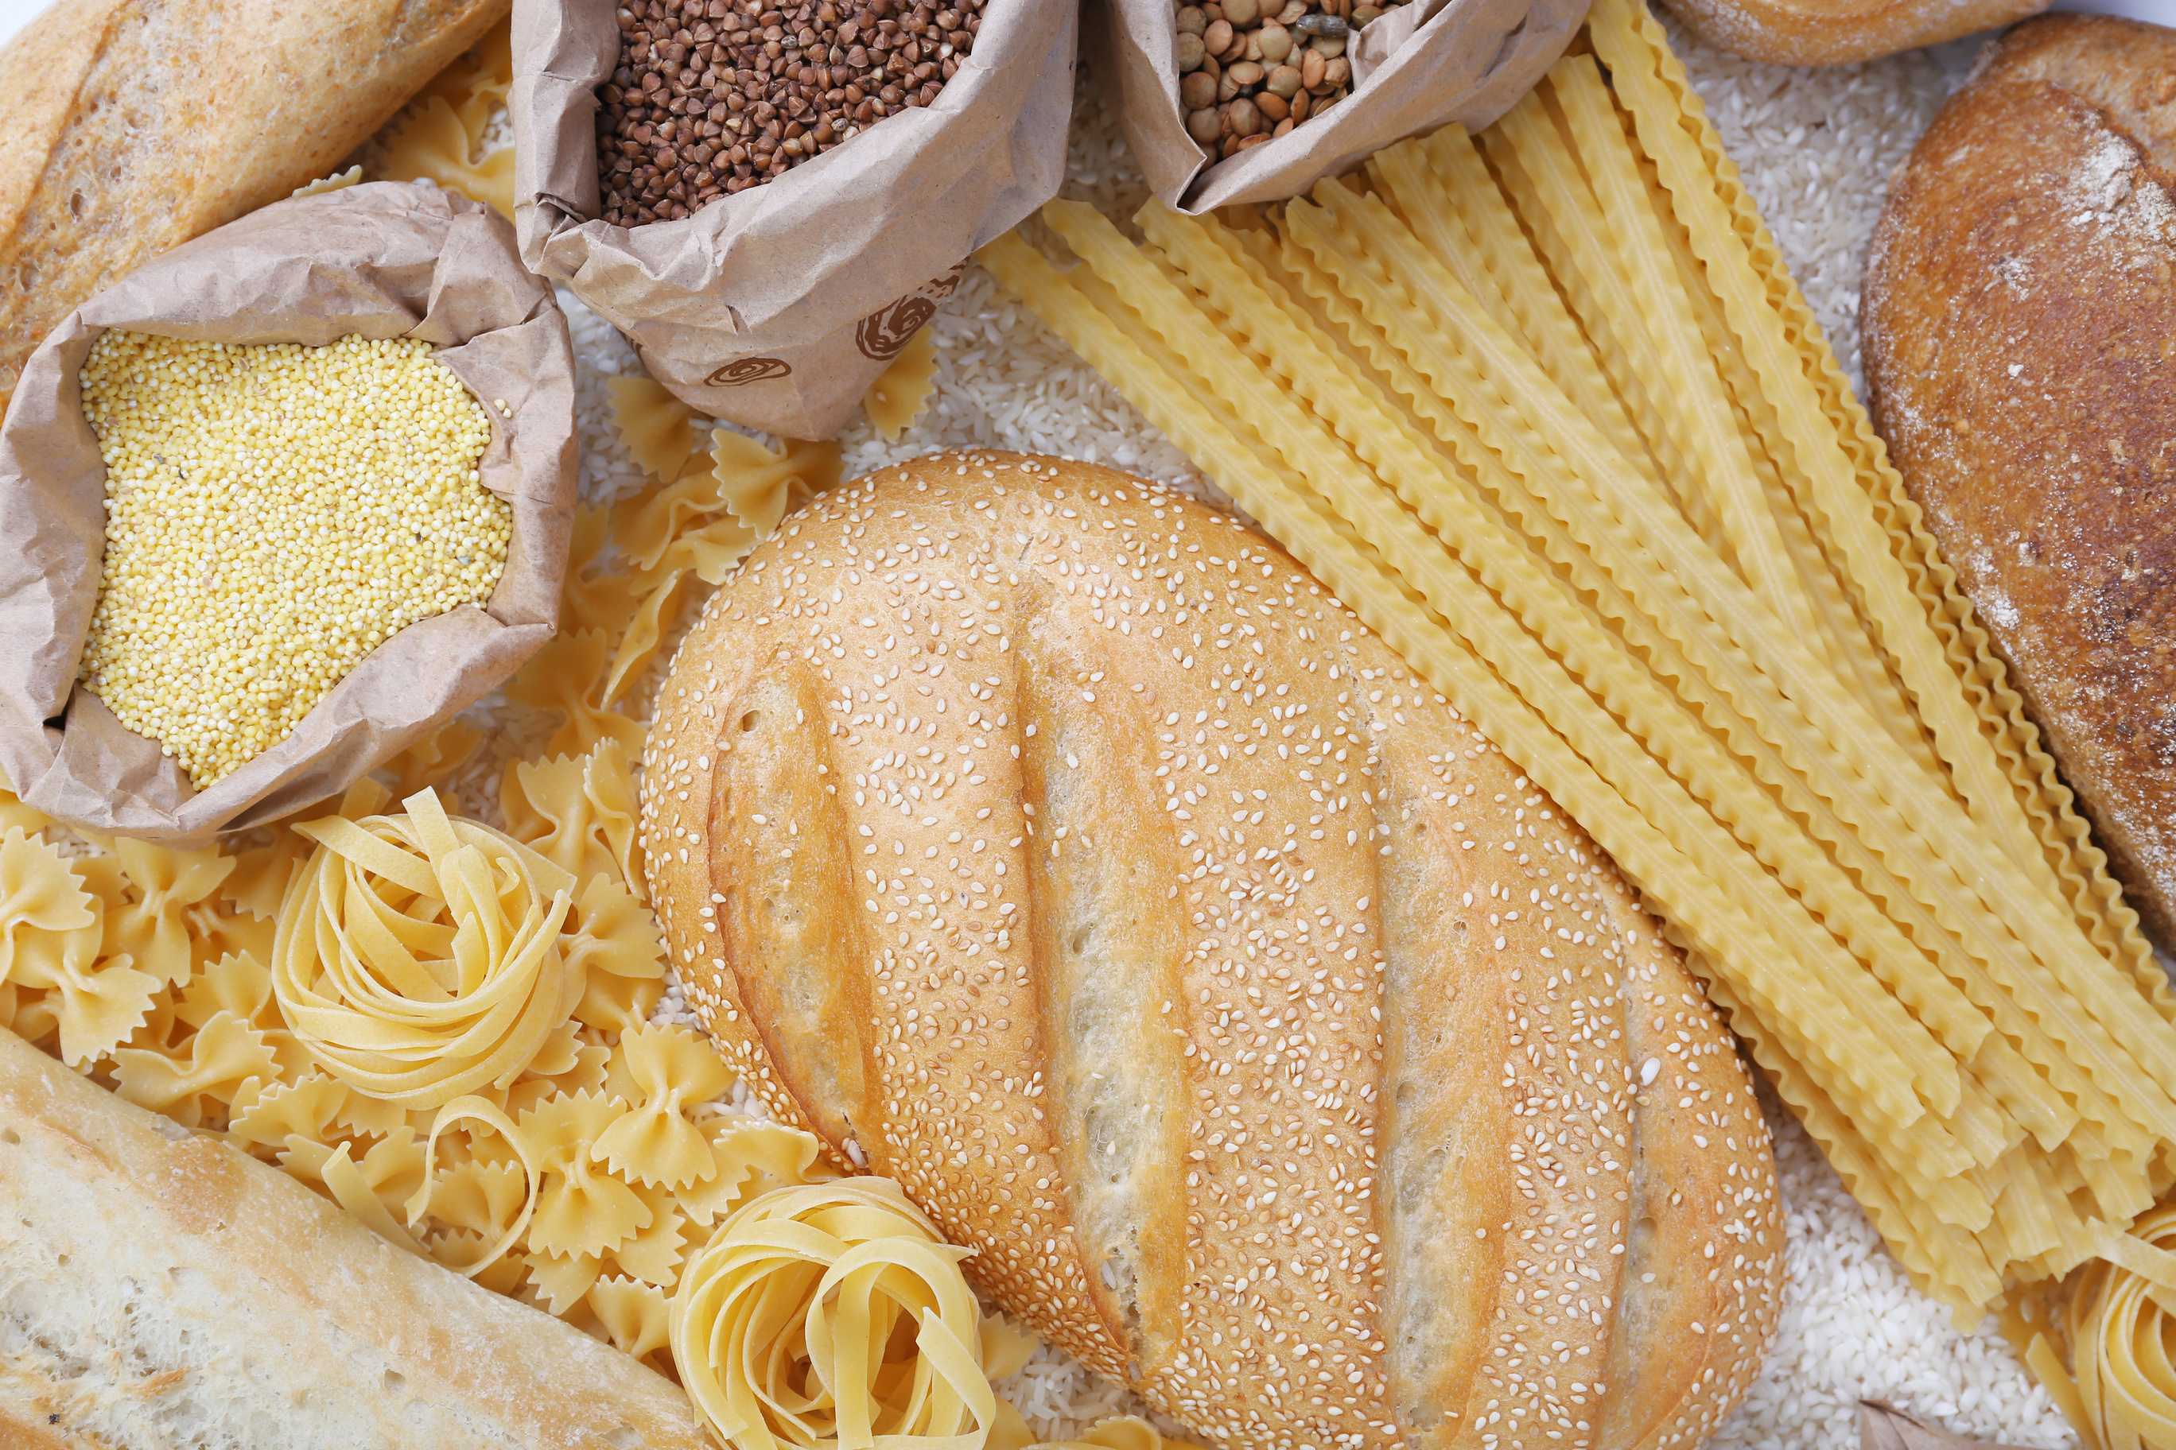

Carbohydrates
Carbohydrates are the body’s main source of energy. They help fuel your brain, muscles, and all your daily activities.
Bread
03
Rice
Bananas
School
© On The Mark Curriculum OTM412-ON

Slide 8

04
Water keeps your body hydrated and helps every organ function properly. It also helps transport nutrients to the cells.
Water
Water
Cucumber
Watermelon
© On The Mark Curriculum OTM412-ON

Slide 9

Vitamins
Vitamins boost your immune system, keep your skin and eyes healthy, and help your body release energy from food. They also play a role in healing wounds.
05
Oranges (Vitamin C)
Carrots (Vitamin A)
Milk (Vitamin D)
© On The Mark Curriculum OTM412-ON

Slide 10
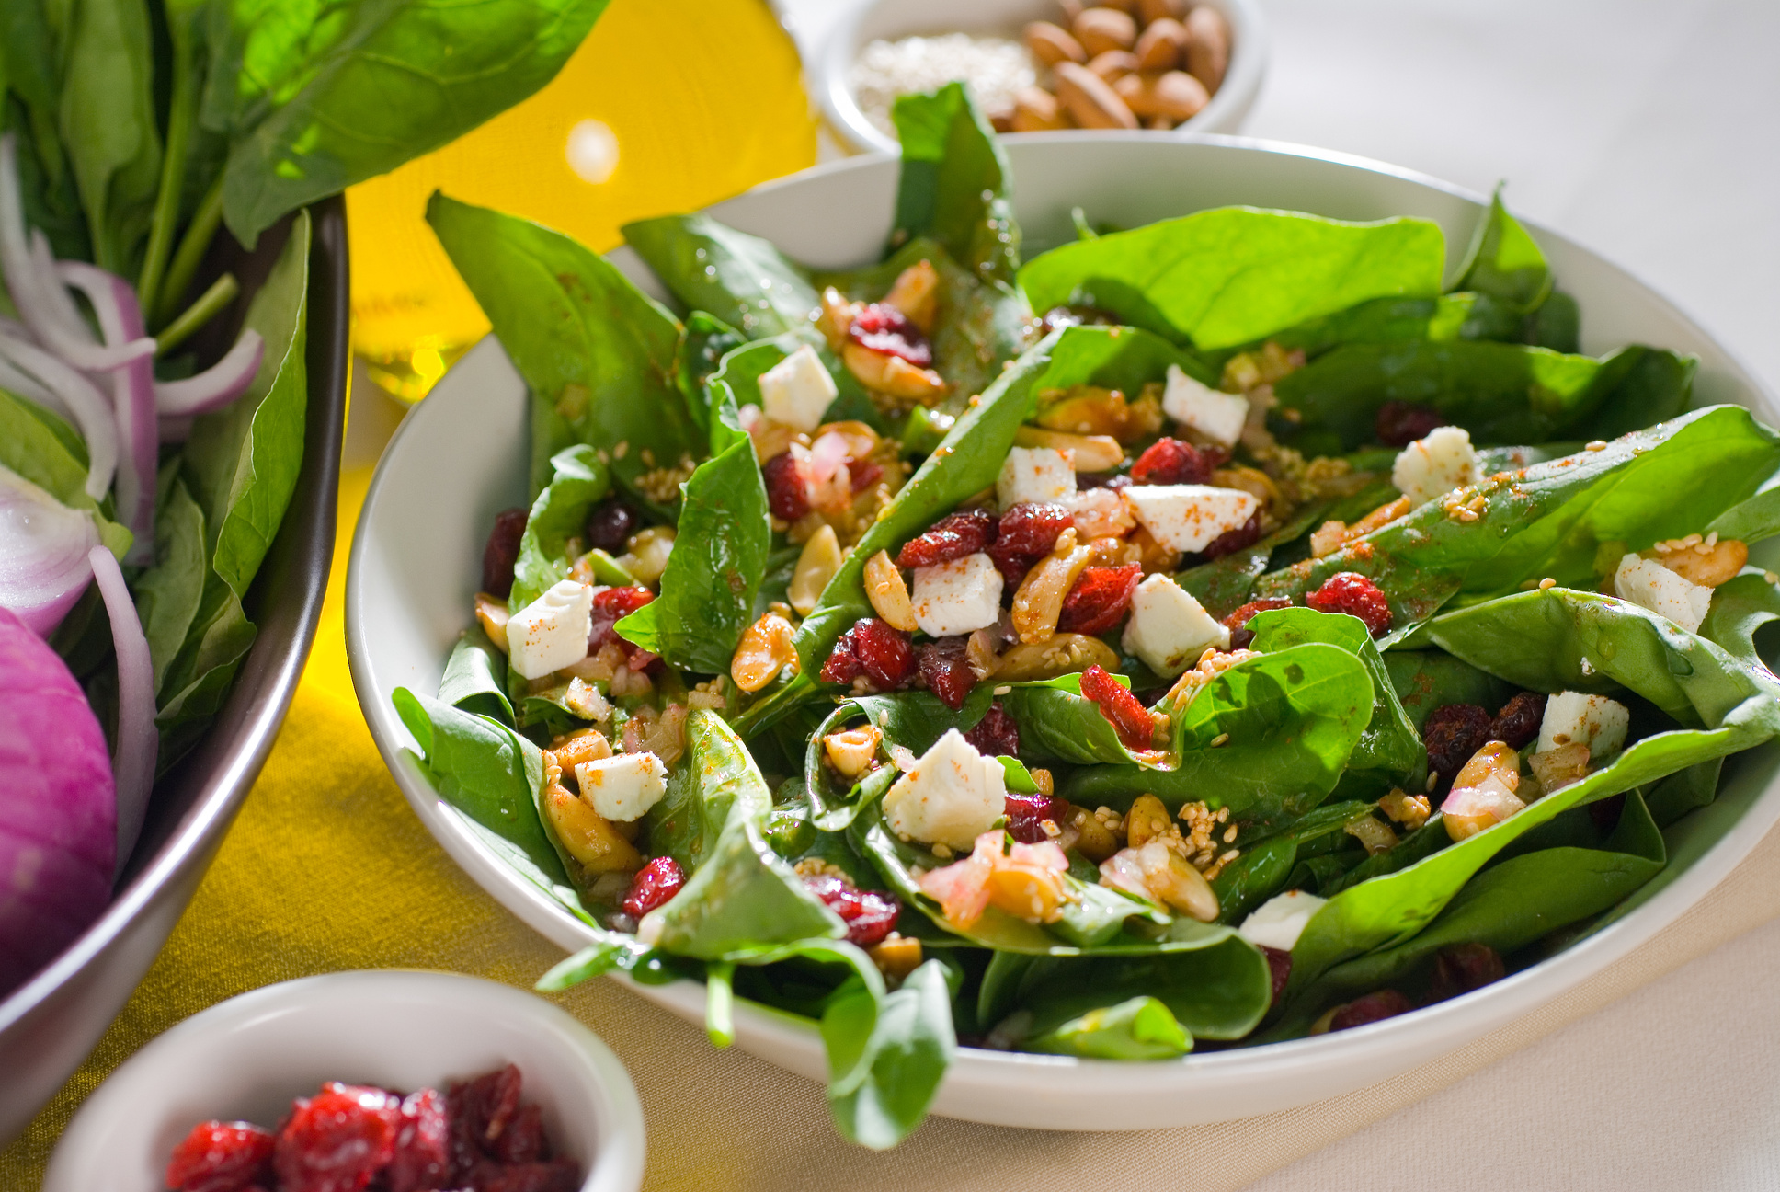
06
Minerals
Minerals like calcium and iron are essential for strong bones, healthy teeth, and carrying oxygen in your blood. They also help muscles and nerves work properly.
Milk (calcium)
Spinach (iron)
Almonds (magnesium)
© On The Mark Curriculum OTM412-ON

Slide 11



Nutrients
in Action
Fats
Carbohydrates
Minerals
© On The Mark Curriculum OTM412-ON

Slide 12
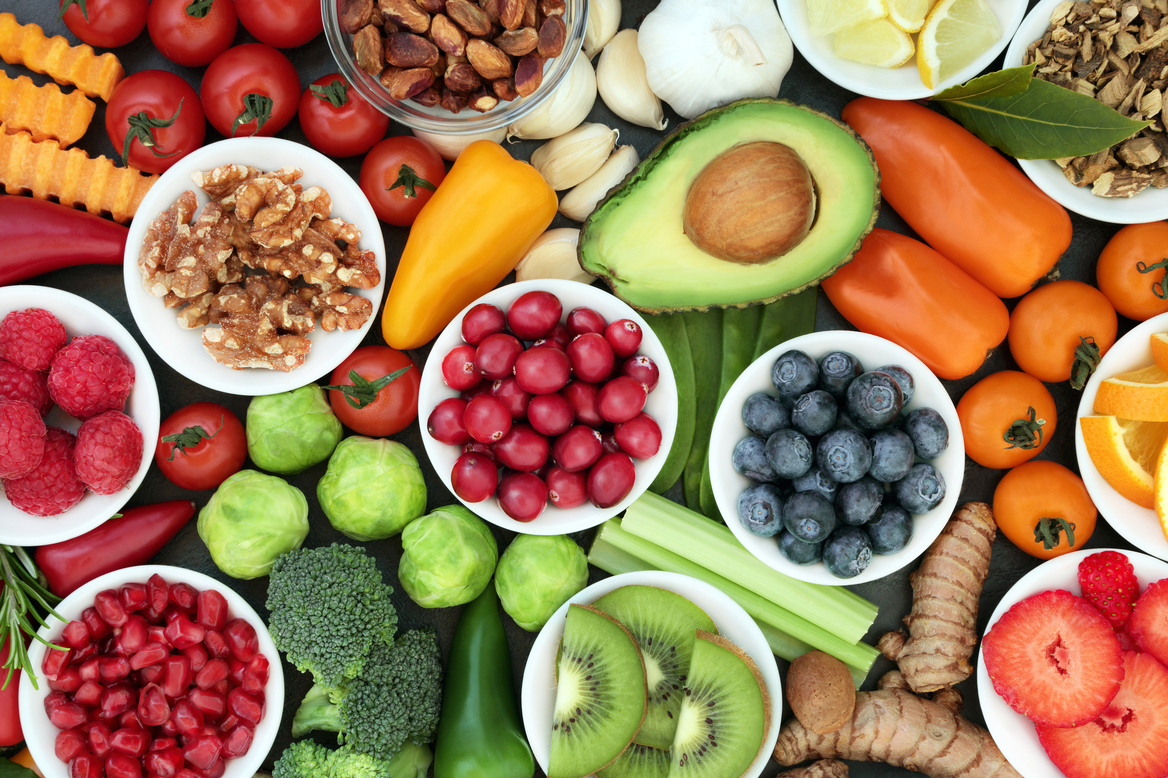





Recap and
Review
Can you name all six nutrients and one food source for each?
© On The Mark Curriculum OTM412-ON

Slide 13


Homwork
Extension Task
Food Diary Worksheet
Track your meals for a day. Reflect on what you ate and how it made you feel.
© On The Mark Curriculum OTM412-ON

